Slide 1
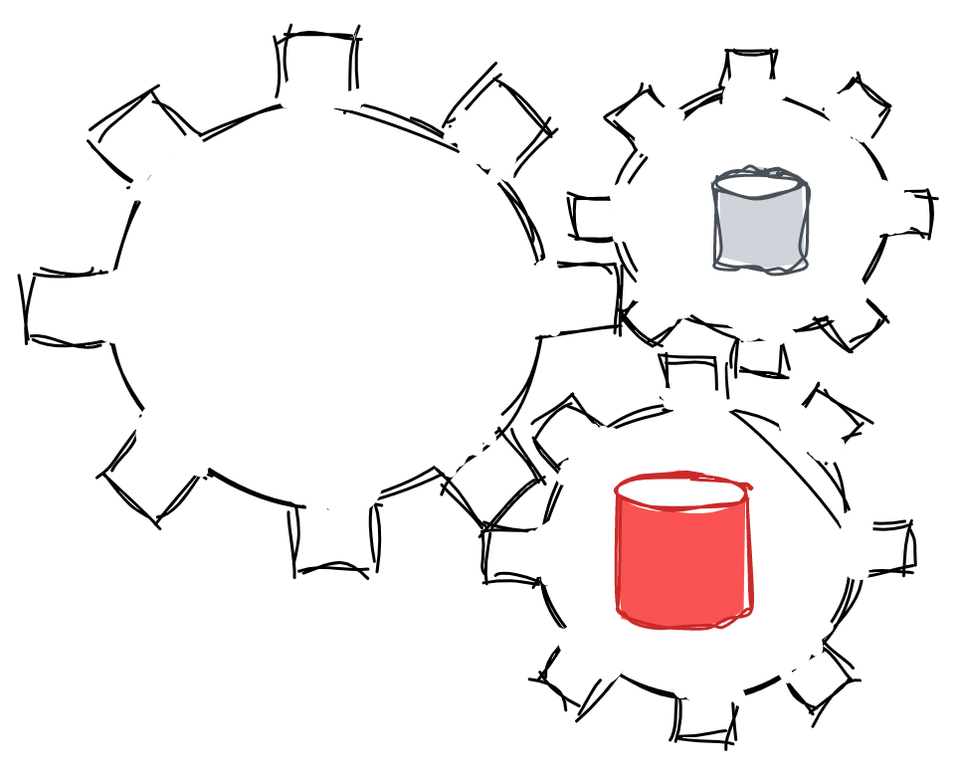
Preprocessing Example
Cleaning operations
Wrangling operations
Notes:
Further Explanation

Slide 2

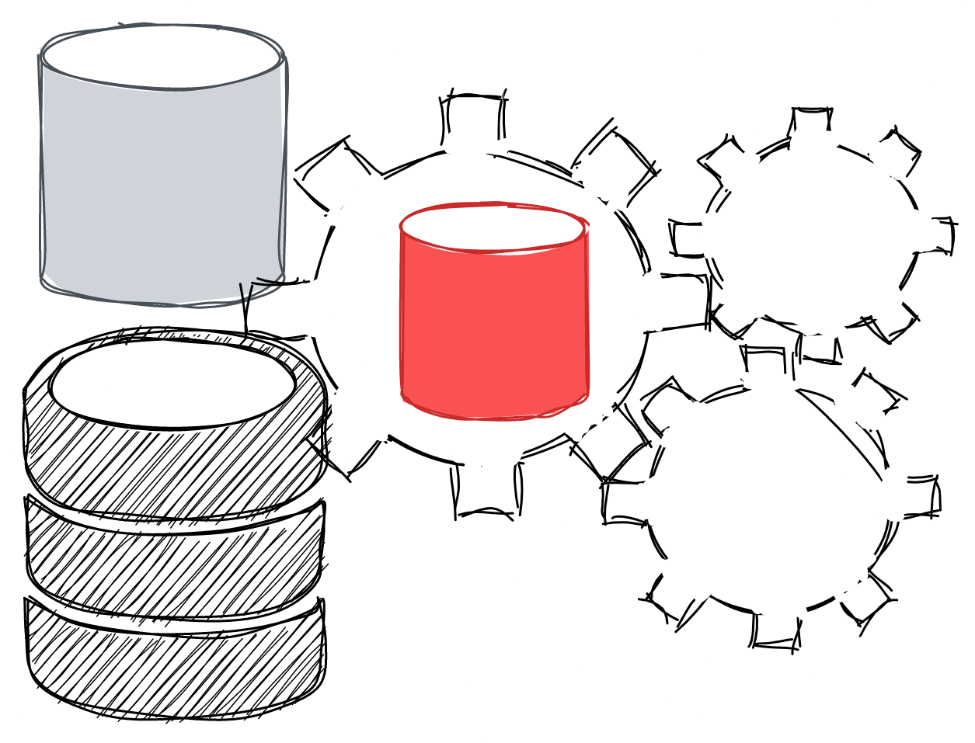
Data Science – Data Preparation
Data Pre-processing Example
Dataset name: 80 Cereal (from Kaggle, original dataset)
Description: This dataset provides a list of 80 different types of cereals from different manufactures and brands; it provides users with the cereal's manufacturer, type, nutritional benefits, and a rating.
Fields in the database: name, manufacturer, type, nutritional factors (calories, protein, fat sodium, fiber, carbohydrates, sugars, potassium, vitamins), rating
Analysis Goal: Let us use this dataset with the intention to understand the effect of nutritional benefits on a particular brands rating.
Note* the dataset below only contains a sub-section of the original "80 Cereal; in additional, "dirty" data has been added to it, in order to showcase the role of pre-processing.
from Amazon
Notes:
Further Explanation

Slide 3
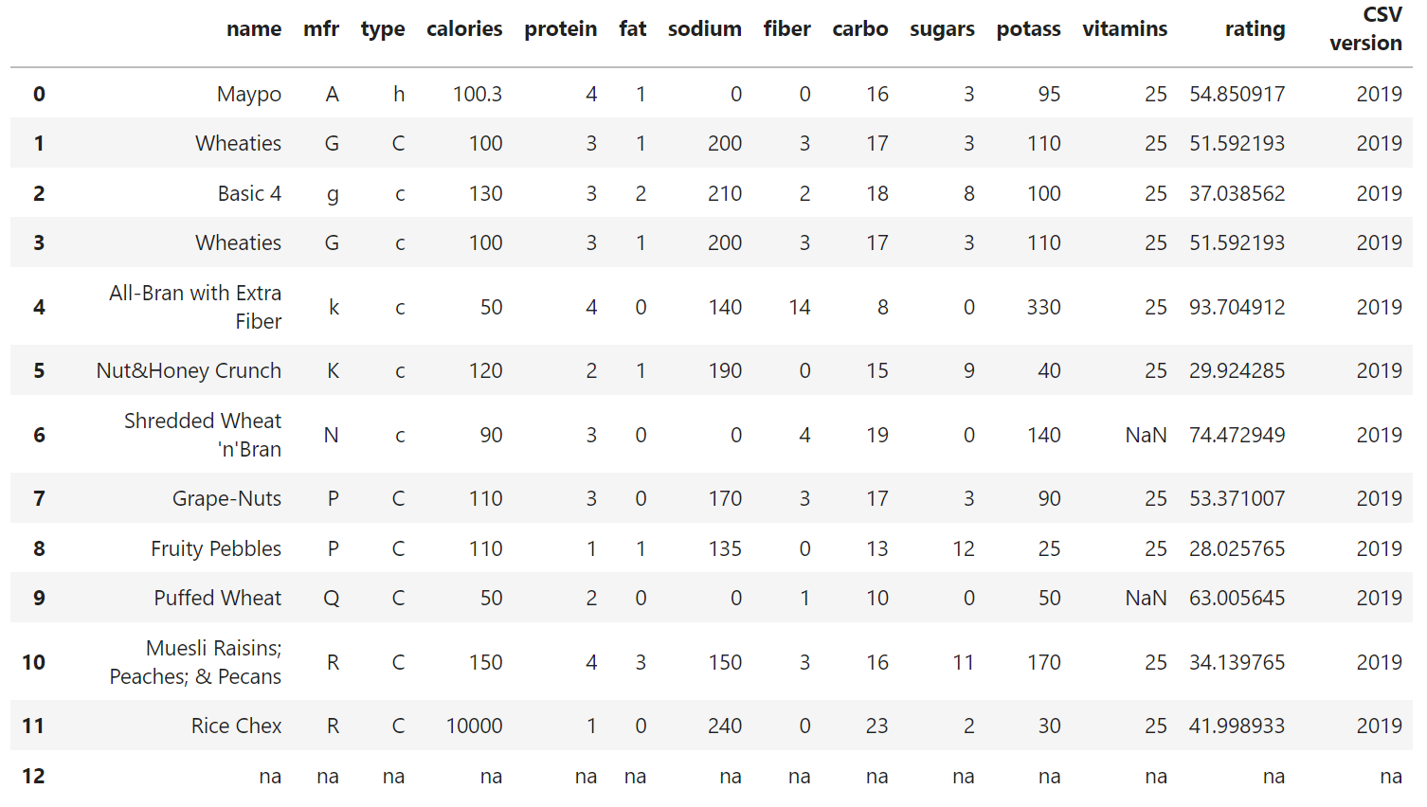
Data Science – Data Preparation
Data Pre-processing Example
Data
Sample
Notes:
Further Explanation

Slide 4
Data Science – Data Preparation
Data Pre-processing: Cleaning
Remove
Irrelevant
Data
Notes:
Further Explanation

Slide 5
Data Science – Data Preparation
Data Pre-processing: Cleaning
Remove
Irrelevant
Data
Notes:
Further Explanation

Slide 6
Data Science – Data Preparation
Data Pre-processing: Cleaning
Remove
Irrelevant
Data
Notes:
Further Explanation

Slide 7
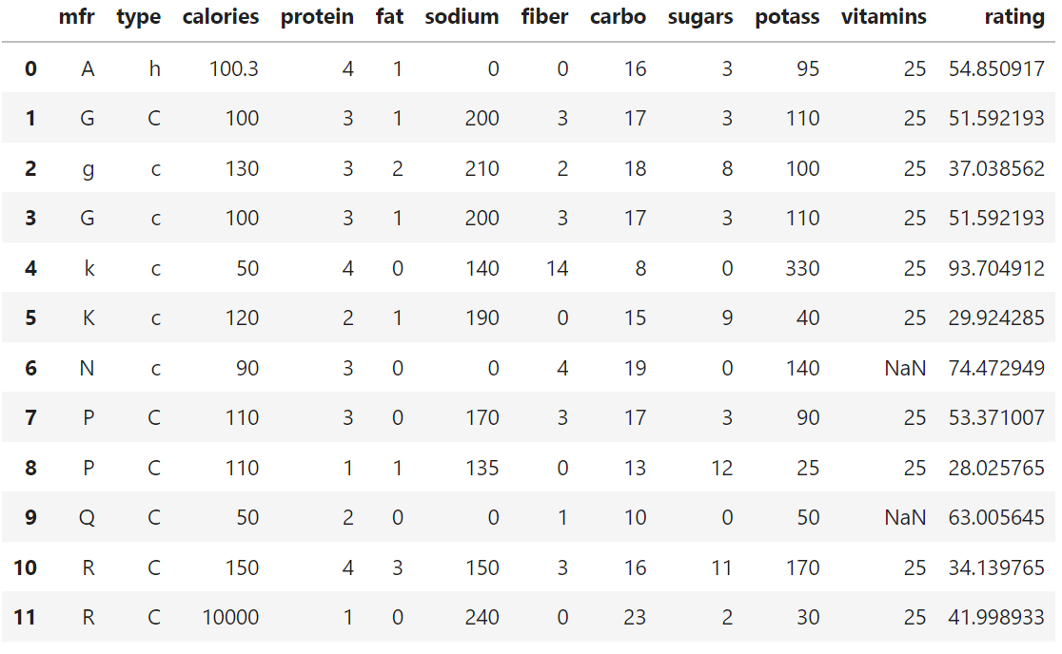
Data Science – Data Preparation
Data Pre-processing: Cleaning
Notes:
Further Explanation

Slide 8
Data Science – Data Preparation
Data Pre-processing: Cleaning
Fix
Structural
Errors
Notes:
Further Explanation

Slide 9
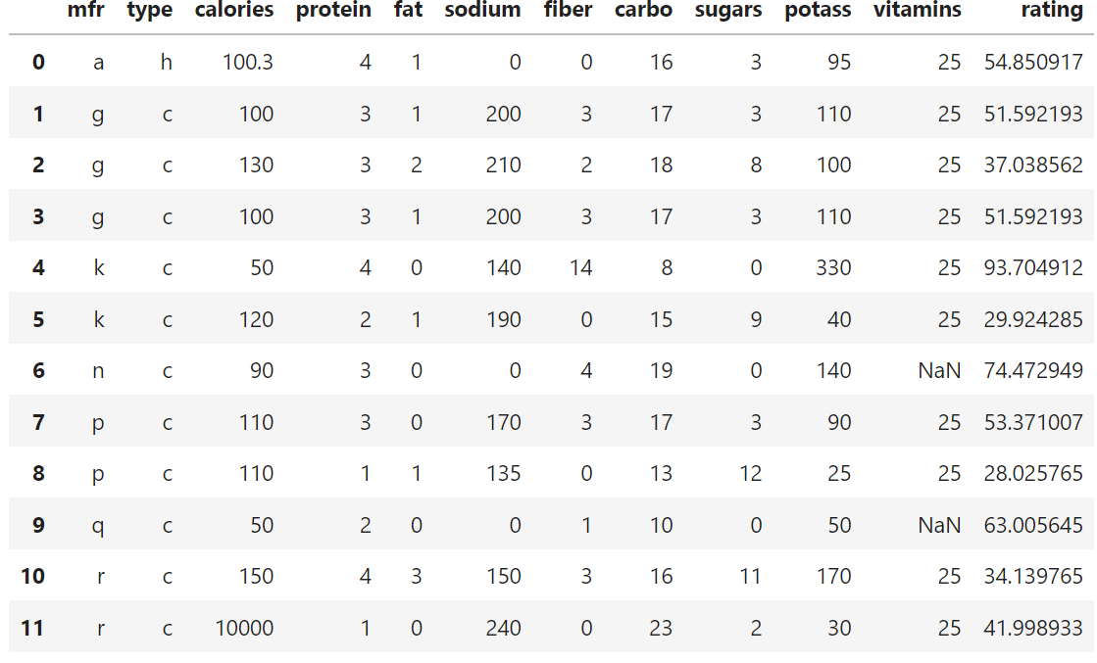
Data Science – Data Preparation
Data Pre-processing: Cleaning
Notes:
Further Explanation

Slide 10
Data Science – Data Preparation
Data Pre-processing: Cleaning
Remove
Duplicates
Notes:
Further Explanation

Slide 11
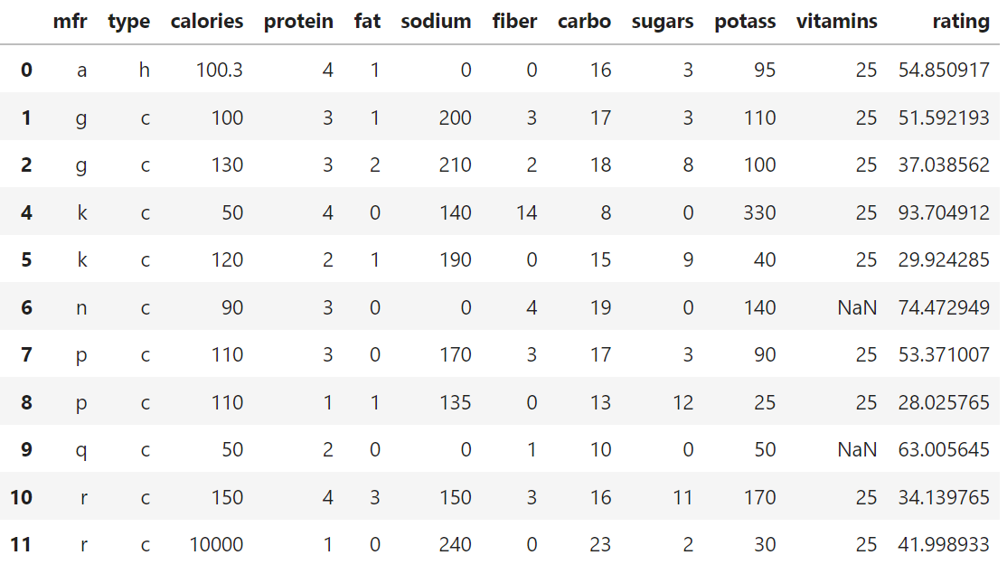
Data Science – Data Preparation
Data Pre-processing: Cleaning
Notes:
Further Explanation

Slide 12
Data Science – Data Preparation
Data Pre-processing: Cleaning
Missing
Values
(impute
median)
Notes:
Further Explanation

Slide 13
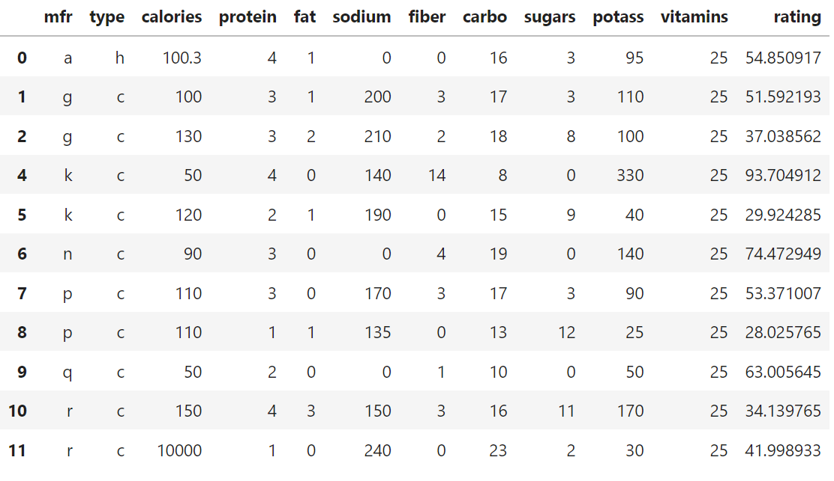
Data Science – Data Preparation
Data Pre-processing: Wrangling
Notes:
Further Explanation

Slide 14
Data Science – Data Preparation
Data Pre-processing: Wrangling
Outlier
(remove
observation)
Notes:
Further Explanation

Slide 15
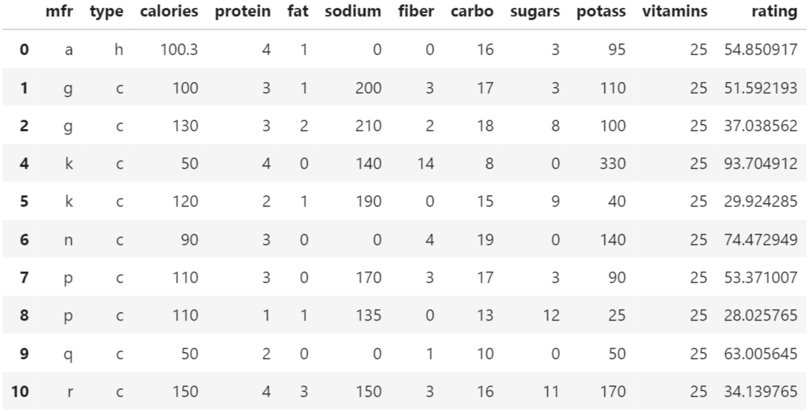
Data Science – Data Preparation
Data Pre-processing: Wrangling
Notes:
Further Explanation

Slide 16
Data Science – Data Preparation
Data Pre-processing: Wrangling
Encoding
("mfr"&"type")
Notes:
Further Explanation

Slide 17
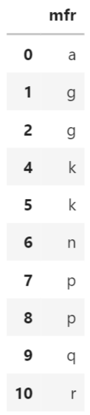
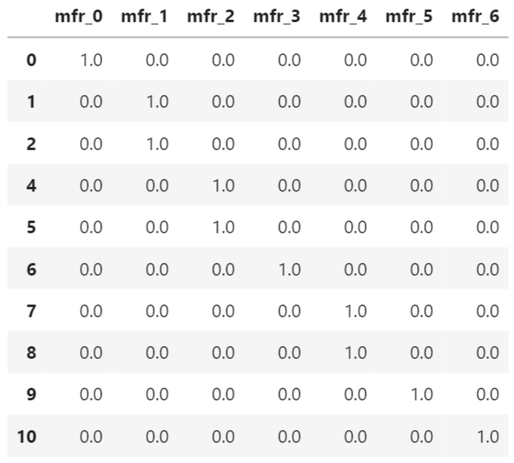
Data Science – Data Preparation
a | g | k | n | p | q | r
Data Pre-processing: Wrangling
Encoding
(one hot
encoding
"mfr")
Notes:
Further Explanation

Slide 18
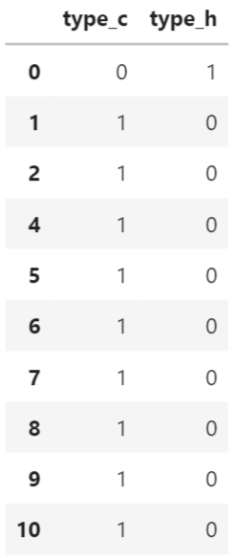
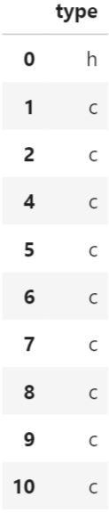
Data Science – Data Preparation
c | h
Data Pre-processing: Wrangling
Encoding
(Dummy variable
"type")
Notes:
Further Explanation
https://stattrek.com/statistics/dictionary.aspx?definition=dummy-variable

Slide 19
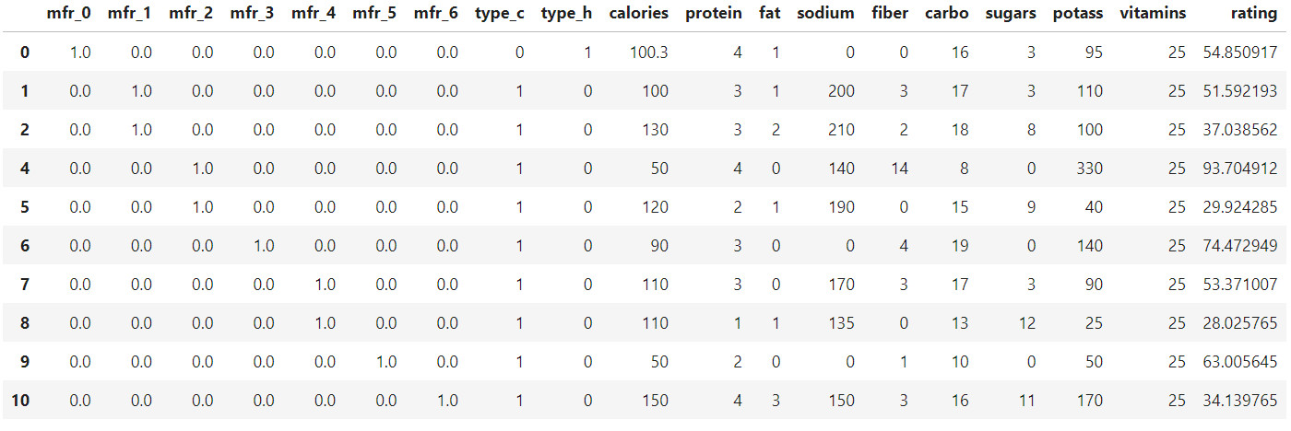
Data Science – Data Preparation
Data Pre-processing: Results (ready for analysis!)
Notes:
Further Explanation

Slide 20
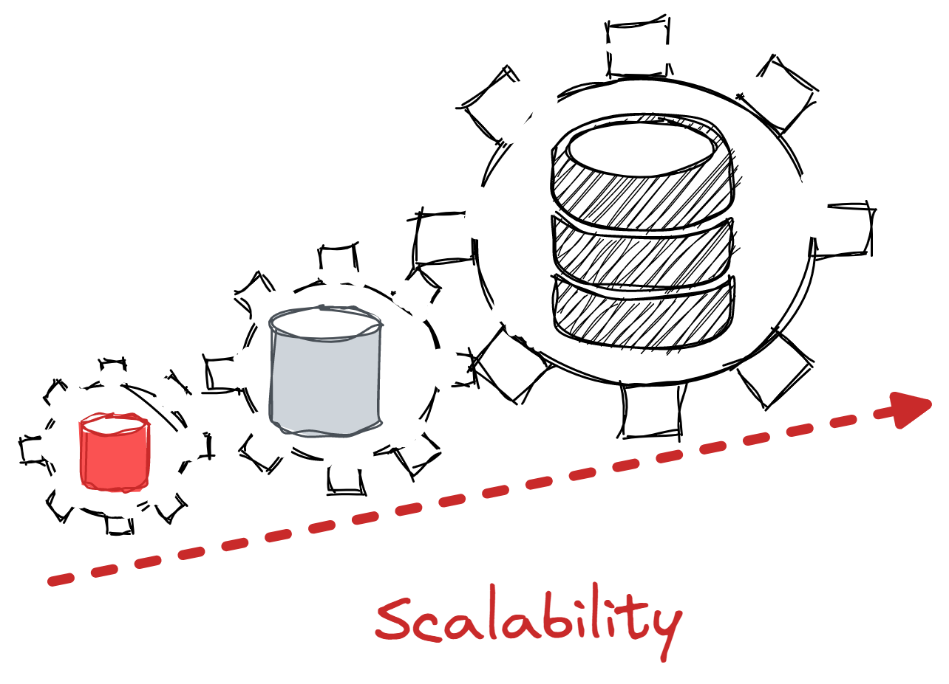
Data Science – Data Preparation
Data Pre-processing at Scale
Datasets come in all shapes and forms in accordance to their domains nature. A dataset might have a few hundred (Iris dataset), a few thousand (school ranking), or a few million (movie ranking) observations.
Even in the case where a dataset might be perceived as small (e.g. a hundred observations), performing manual pre-processing (i.e. checking each row individually) is a far too laborious tasks that would require extreme time commitment on the part of the analyst and would still be susceptible to errors (e.g. missing a particular row).
"Hence, in order to perform pre-processing at a scale to save time and upkeep a high level of quality, data scientists make extensive use of tools such as Python and R that enable them to achieve faster and better data pre-processing."
Notes:
Further Explanation

Slide 21
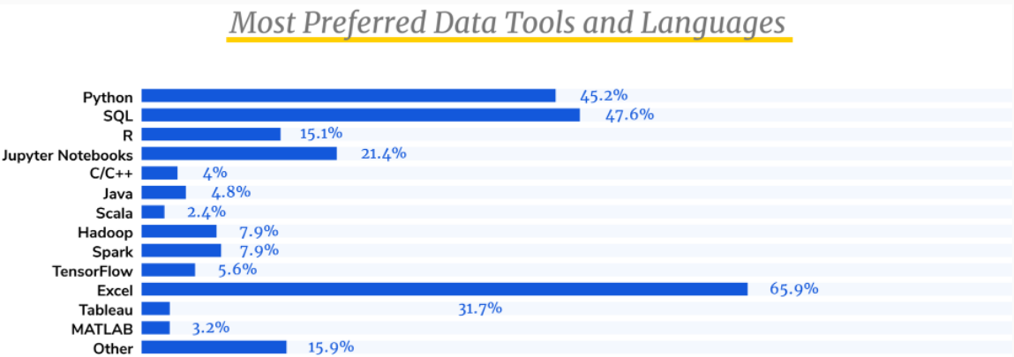
Data Science – Data Preparation
Data Pre-processing Tools
Data Scientists rely on a number of specialized tools and programs developed specifically for data cleaning, analysis, and modeling. Although the survey revealed that Excel is the most widely used program, data scientists rely on Python & R to perform data pre-processing tasks.
source BrainStation
Notes:
Further Explanation

Slide 22
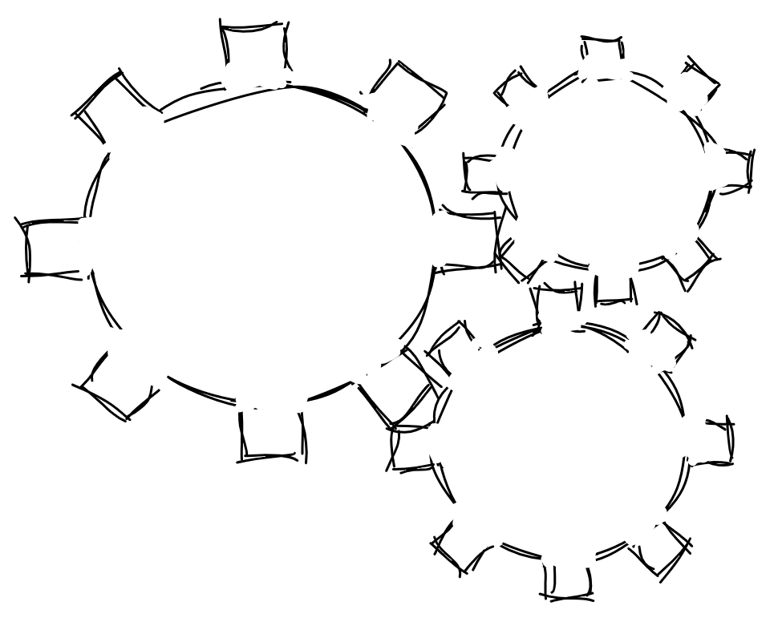


Data Science – Data Preparation
Python or R?
When it comes to data pre-processing and manipulation Python or R are the top choices. Often, there is a debate on which tool is better and the answers tend to be a mixed bag, with many favoring Python and as many more favoring R.
Python ,"a high-level, interpreted, general-purpose programming language. Its design philosophy emphasizes code readability with the use of significant indentation."
R, "R is a free software environment for statistical computing and graphics."
Both Python and R are free, open-source languages that can run on Windows, macOS, and Linux. Both can handle just about any and both are considered relatively easy languages to learn, especially for beginners.
"So which should you choose to learn (or learn first)?"
Notes:
Further Explanation

Slide 23
Data Science – Data Preparation
Python or R?
Python​ | R​ | Similarities
Roots from computer science | Roots from statistics | ​Free
​Great for handling big datasets, applying deep learning models and machine learning pipelines at scale | ​Great for graphics and visualizations | ​Easy to learn
​Non statistical tasks (e.g. web scraping, database connections, software engineering) | ​Rich, diverse and meticulous statistical models (~14k packages) | ​Common in data science
​Popular among programmers and used in diverse domains | Loved by statisticians, academic researchers, and engineers | ​Open source
"General, intuitive and fast" | "Statistics oriented" | Robust communities ( documentation, examples)
Notes:
Further Explanation
https://www.datacamp.com/community/tutorials/r-or-python-for-data-analysis
"While Python is often praised for being a general-purpose language with an easy-to-understand syntax, R's functionality was developed with statisticians in mind, thereby giving it field specific advantages such as great features for data visualization"
https://www.rstudio.com/blog/r-vs-python-what-s-the-best-for-language-for-data-science/
"Most interfaces for novel machine learning tools are first written and supported in Python, while many new methods in statistics are first written in R."

Slide 24
Data Science – Data Preparation
Python or R?
Popular Python Packages & Libraries
TASK | PACKAGE | DESCRIPTION
Manipulation | NumPy | The fundamental package for scientific numerical computing in Python.
 | SciPy | A collection of mathematical algorithms and functions built on NumPy.
 | Pandas | Pandas are used for data manipulation and analysis. It offers data structures and operations for manipulating numerical tables and time series.
Modeling | Sci-kit | Scikit-learn (Sklearn) is the most useful and robust library for machine learning in Python (classification, regression, clustering and dimensionality reduction).
 | Stats-models | Statsmodels allows users to explore data, estimate statistical models, and perform statistical tests.
Visualizations | Matplotlib | Library for creating static, animated, and interactive visualizations in Python.
 | Seaborn | Library based on matplotlib. It provides a high-level interface for drawing attractive and informative statistical graphics.
Notes:
Further Explanation

Slide 25
Data Science – Data Preparation
Python or R?
Popular R Packages & Libraries
TASK | PACKAGE | DESCRIPTION
Manipulation | Dplyr | A fast, consistent tool for working with data frame like objects, both in memory and out of memory.
 | Tidyr | Tools to help to create tidy data, where each column is a variable, each row is an observation, and each cell contains a single value. It also includes tools for working with missing values (both implicit and explicit).
 | Data.table | Fast aggregation of large data (e.g. 100GB in RAM), offers a natural and flexible syntax, for faster development.
Modeling | Caret; Mlr3 | Miscellaneous functions for training and plotting classification and regression models.
Visualizations | Ggplot2 | A system for 'declaratively' creating graphics, based on "The Grammar of Graphics". One of the best library for data visualization in R (and beyond).
 | Ggraph | Everything has some limitations, so is an extension of ggplot2 and takes away all the limitations of ggplot2.
Notes:
Further Explanation
Top R packages
https://www.r-bloggers.com/2021/04/15-essential-packages-in-r-for-data-science/
https://towardsdatascience.com/top-r-libraries-for-data-science-9b24f658e243
https://www.udacity.com/blog/2021/01/best-r-packages-for-data-science.html (knitr for generating reports)

Slide 26
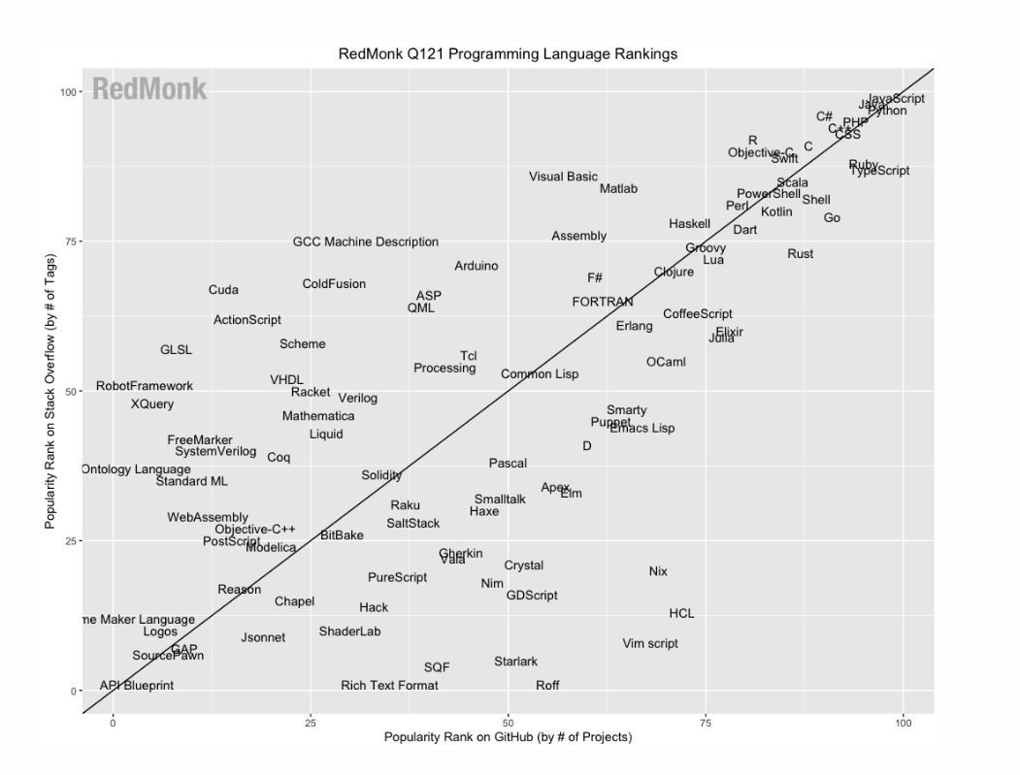
Data Science – Data Preparation
Python or R?
from RedMonk
Notes:
Further Explanation

Slide 27
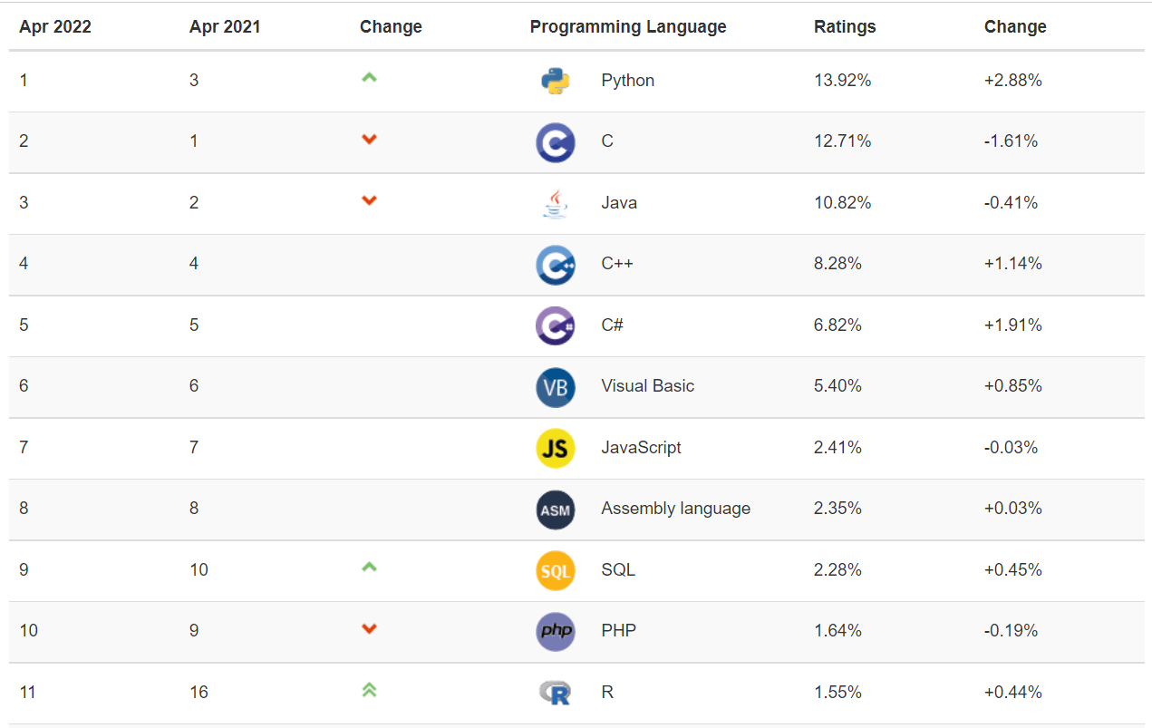
Data Science – Data Preparation
Python or R?
from TIOBE
Notes:
Further Explanation

Slide 28
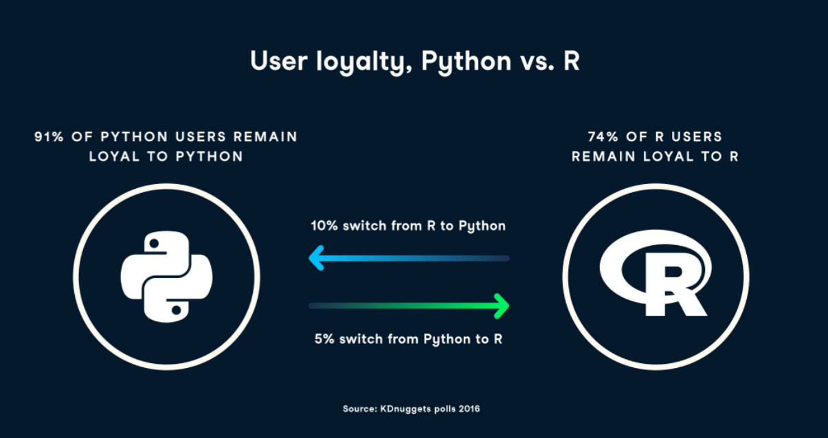
Data Science – Data Preparation
Python or R?
from DataCamp
Notes:
Further Explanation

Slide 29

Data Science – Data Preparation
Python AND R!
In many ways, both Python and R are very similar. Open source, free to download for everyone, both languages are well suited for data science tasks — from data manipulation and automation to business analysis and big data exploration, with the main difference that Python is a general-purpose programming language, while R has its roots in statistical analysis.
More often than not, a data scientist might find themselves using both in accordance to the task at hand; for example, one might use R to generate some graphics, and switch to Python to deploy a deep learning model.
"Increasingly, the question isn’t which to choose, but how to make the best use of both programming languages for your specific use cases." IBM
Notes:
Further Explanation

Slide 30

Data Science – Data Preparation
Python AND R!
"Generally, there are a lot of people who talk about R versus Python like it’s a war that either R or Python is going to win. I think that is not helpful because it is not actually a battle. These things exist independently and are both awesome in different ways."
"Use whatever makes you happy."
Hadley Wickham, RStudio’s Chief Data Scientist
from Quartz
Notes:
Further Explanation

Slide 31

Data Science – Data Preparation
Python AND R!
Still skeptical? There is an R package, reticulate, that is dedicate exclusively to the relationship between Python and R allowing seamless high-performance interoperability between the two tools.
The package allows
Calling Python from R in a variety of ways (e.g. Python scripts, importing Python modules, and using Python interactively within an R session)
Translating between R and Python objects (e.g. R and Pandas data frames, R matrices and NumPy arrays).
Binding to different versions of Python including virtual environments and Conda environments.
Notes:
Further Explanation

Slide 32
Data Science – Data Preparation
Python or R?
But if you've really got to pick one due to constraints than use the following points to guide you in your final choice.
Team/colleagues, it is wiser to use whatever tools one's team might be using, to enhance collaboration and avoid delays/mistakes.
Task/problem, sometimes the goal is visualization and other times it might be deep learning; Python or R can provide better results according to the nature of the problem.
Constraints, to learn a new technology requires time and resources, which should be taken into account when making a choice.
Standard in industry, each industry has its own "preferences", one should prepare accordingly.
Programming experience, Python seems to be easier to learn and understand by newly interested enthusiasts.
Notes:
Further Explanation

Slide 33
Data Preparation
Python or R?
https://towardsdatascience.com/matplotlib-vs-ggplot2-c86dd35a9378
Notes:
Further Explanation

Slide 34
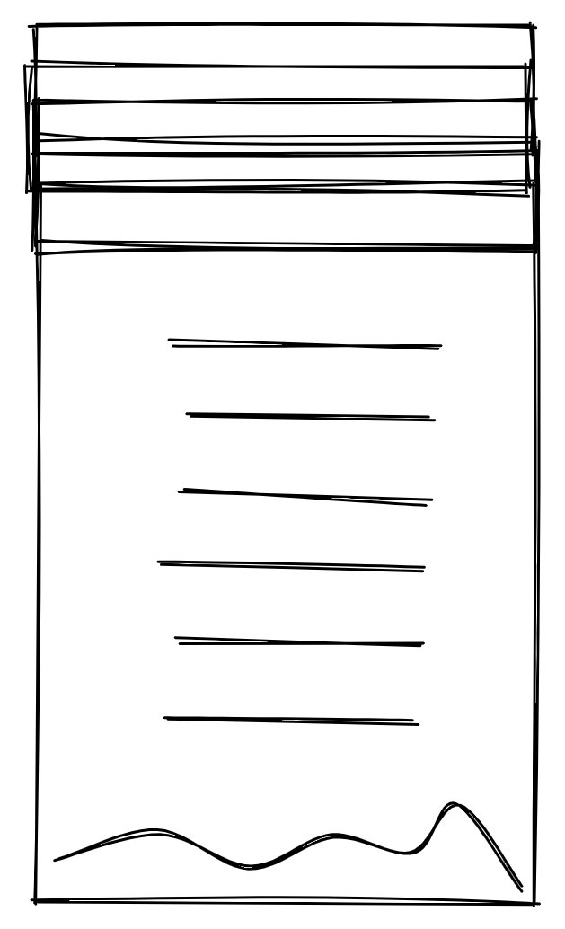
Data Science – Data Preparation
Further Resources
Python vs R
https://www.ibm.com/cloud/blog/python-vs-r
https://www.datacamp.com/tutorial/r-or-python-for-data-analysis
https://www.rstudio.com/blog/r-vs-python-what-s-the-best-for-language-for-data-science/
https://www.capgemini.com/2020/09/do-data-scientists-prefer-r-or-python
Programming Languages
Popular programming languages
What is next for R?
Courses
R Course
Webinar
Books
Python
Notes:
Further Explanation

Slide 35
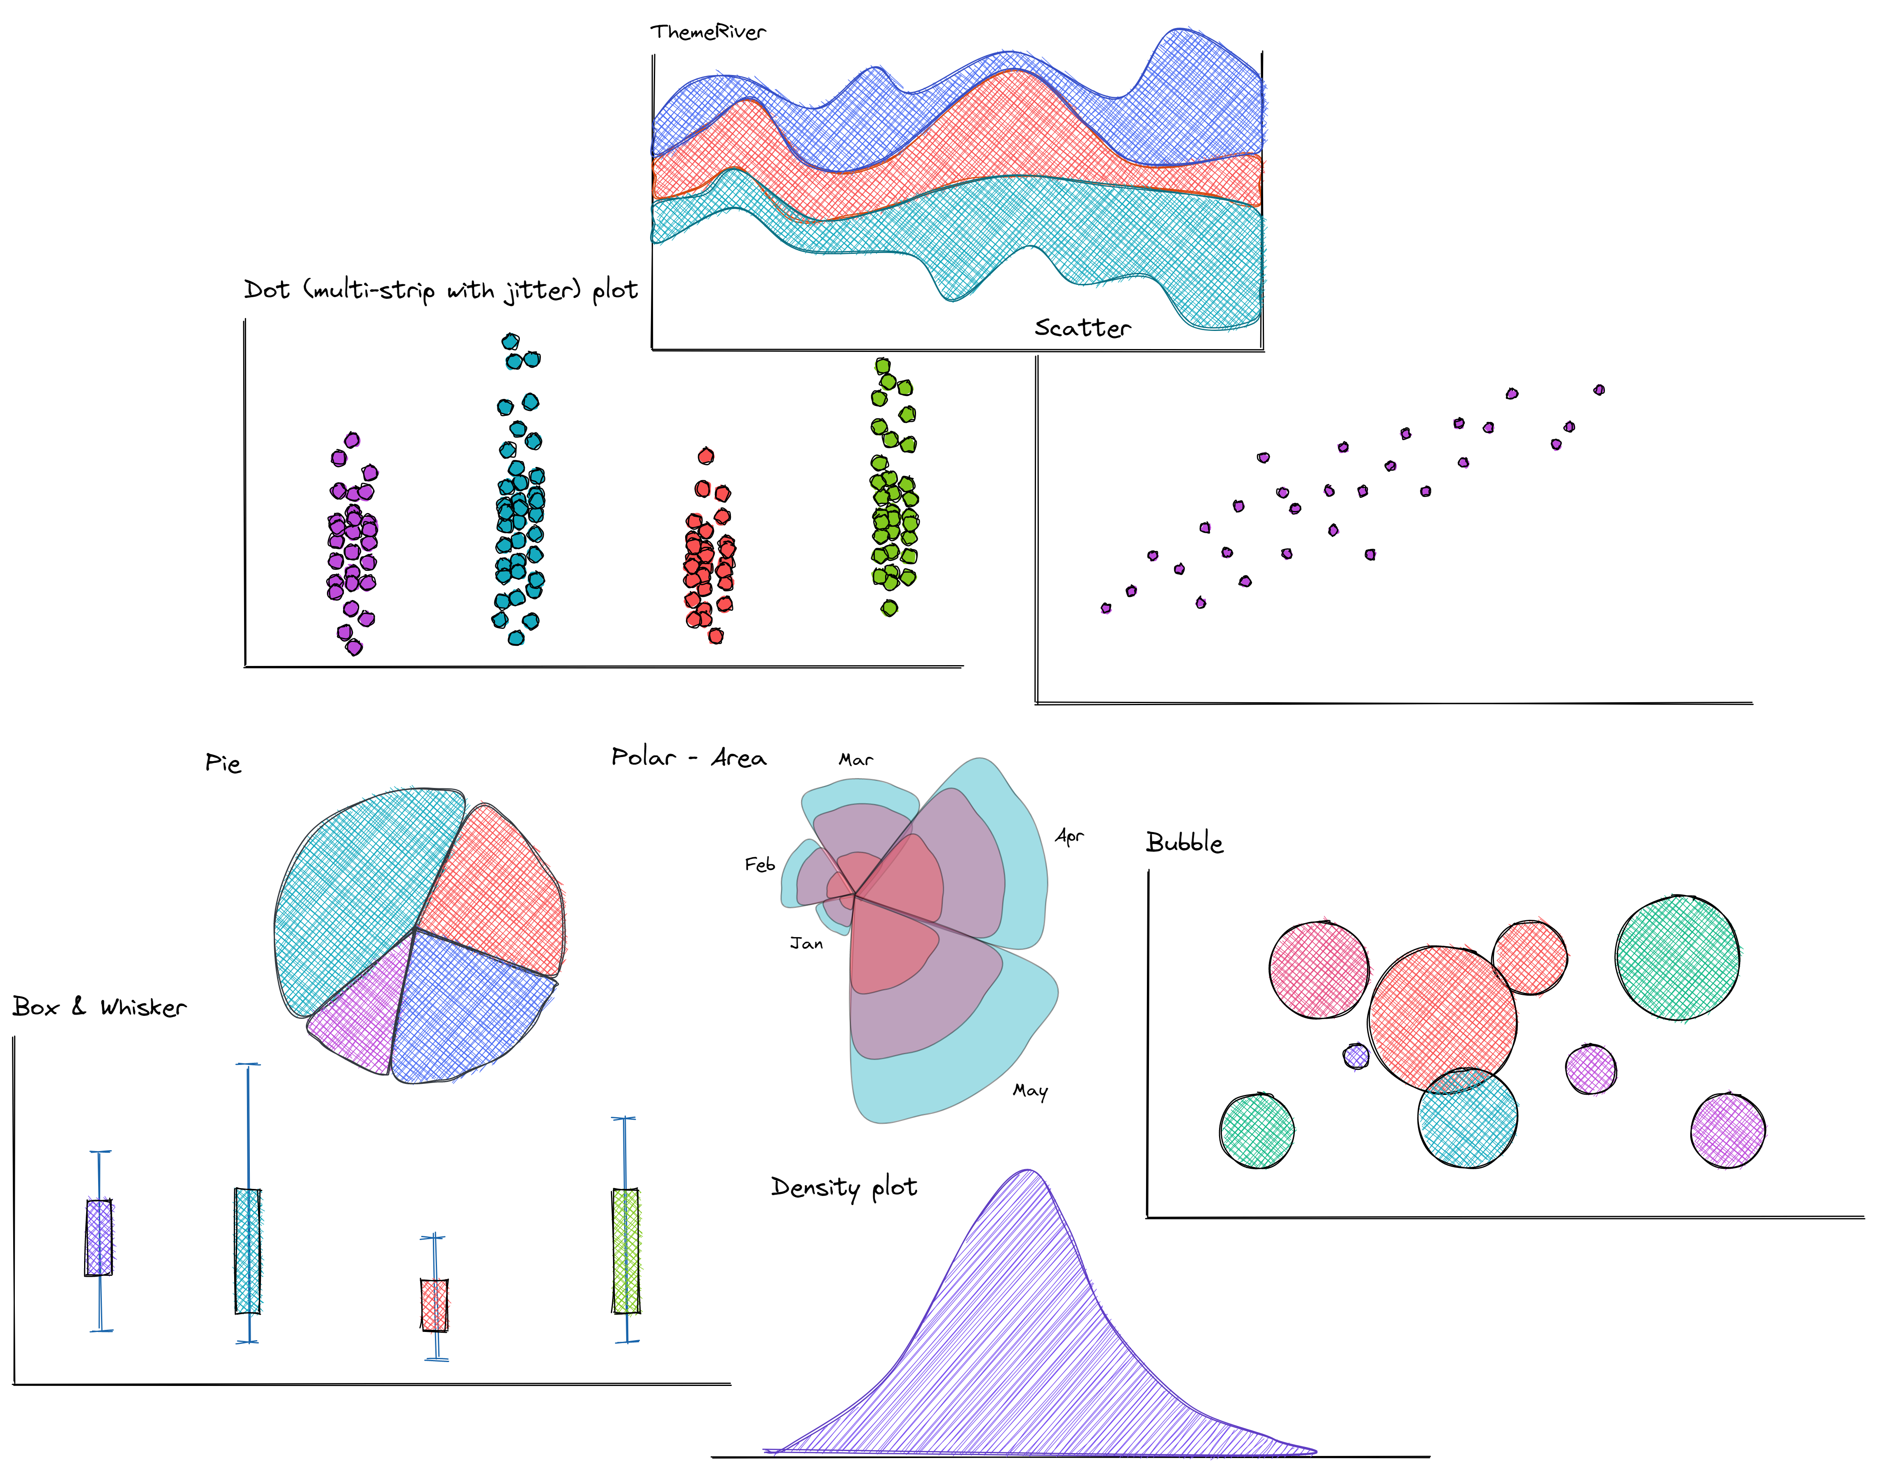
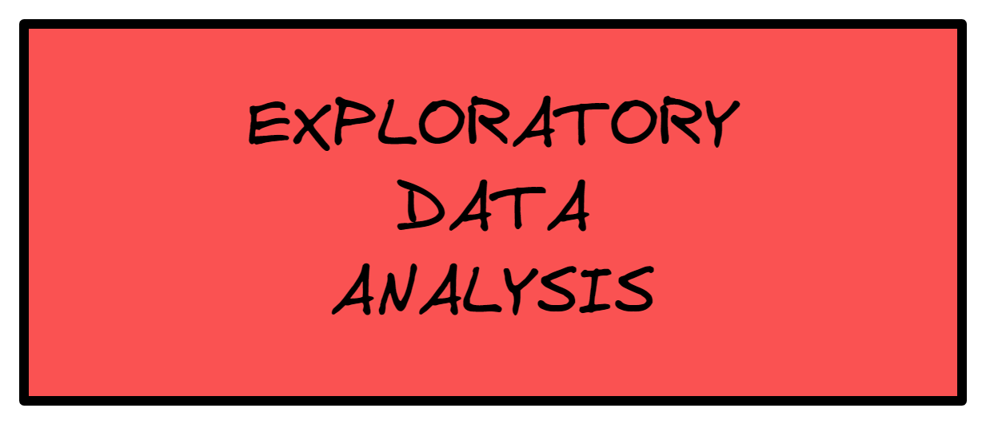

Slide 37
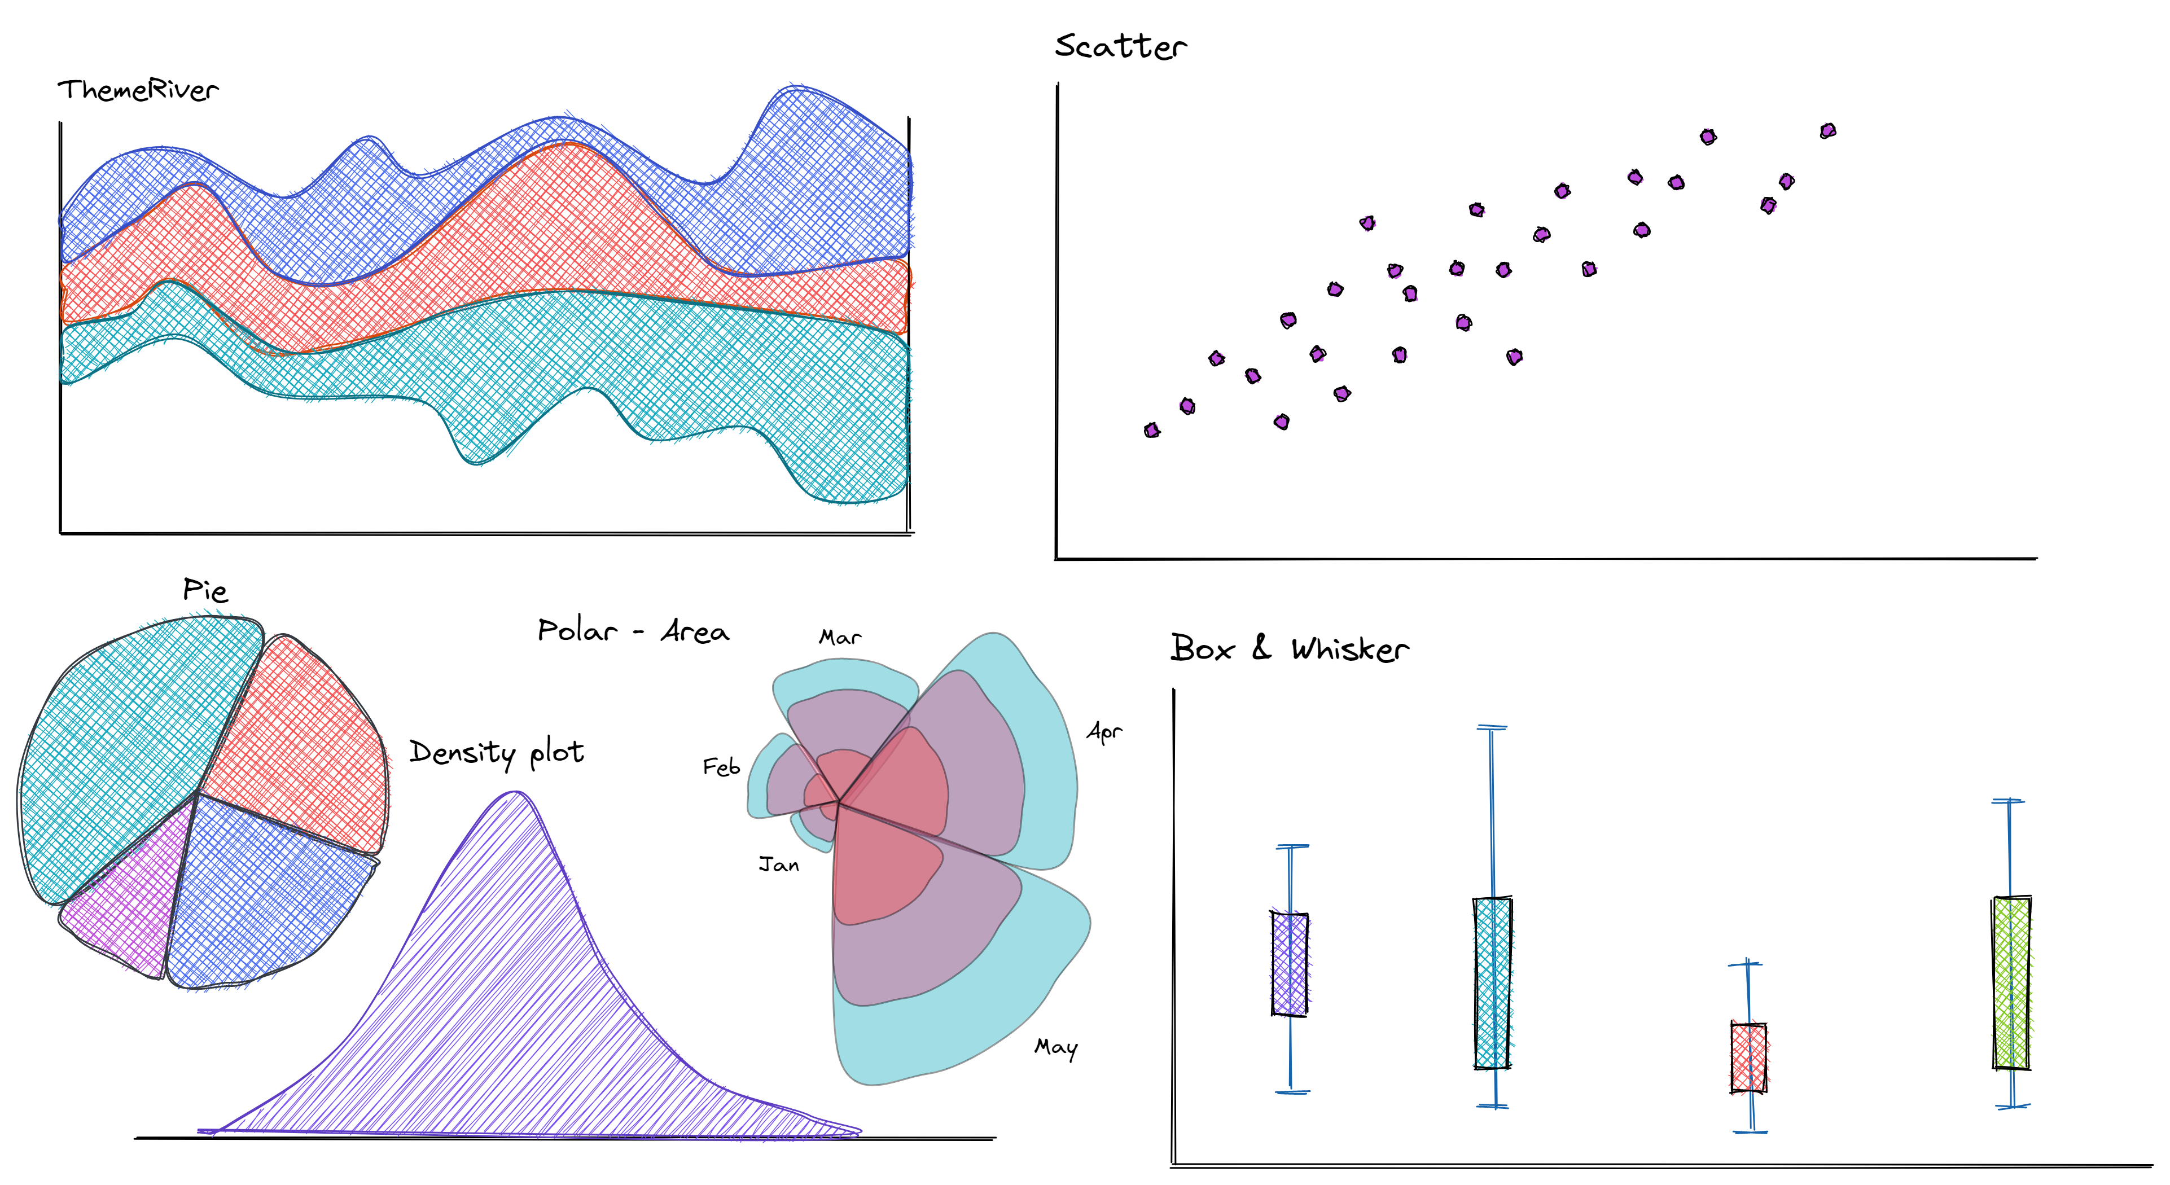

Slide 38

Exploratory Data Analysis
Exploratory Data Analysis (EDA)
Exploratory data analysis has been promoted by John Tukey since 1970 to encourage statisticians to explore the data, and possibly formulate hypotheses that could lead to new data collection and experiments.
"The greatest value of a picture is when it forces us to notice what we never expected to see."
John W. Tukey, Exploratory Data Analysis (1976)

Slide 39
Exploratory Data Analysis
What is EDA? (According to Tukey)
Looking at data, and see what it seems to say. It concentrates on simple arithmetic and easy-to-draw pictures. It regards whatever appearances we have recognized as partial descriptions, and tries to look beneath them for new insights. Its concern is with appearance, not with confirmation.
One should strive to make data more handleable by minds- anything that makes a simpler description possible (e.g. graphics) makes the description more easily handleable.
Pictures based on exploration of data should force their messages upon us. Pictures that emphasize what we already know --are frequently not worth the space they take.
To learn about data analysis, it is right that each of us try many things that do not work.
"It is important to understand what you CAN DO before learning to measure how WELL you seem to have DONE it." Tukey

Slide 40
Exploratory Data Analysis
What is EDA?
Exploratory data analysis (EDA) is an "approach of analyzing data sets to summarize their main characteristics, often using statistical graphics and other data visualization methods."
EDA allows the scientist/researcher to take a bird’s eye view of the data and make some sense of it.
It’s often preceded by the pre-processing phase, but it can often time be done in congruence.
Although specific statistical techniques can be used (e.g. histograms, box plots, scatter plots, ...) , EDA is not a specific set of techniques or a determinate set of procedures.
EDA can be used to see beyond the formal modeling and thereby contrasts traditional hypothesis testing.
"Often, defined as a philosophy- more of an art form than a science."
Notes:
Further Notes
EDA postpones the usual assumptions about what kind of model the data follow, with the more direct approach of allowing the data itself to reveal its underlying structure and model.
EDA is not a mere collection of techniques; EDA is a philosophy as to how we dissect a data set; what we look for; how we look; and how we interpret; and it does so by making use of graphics.

Slide 41
Exploratory Data Analysis
What is EDA?
Most EDA techniques are graphical in nature with a few quantitative techniques. EDA does not impose/force any particular structures on the data (no assumptions). On the contrary, through the use of graphics, it allows for the data to present its structure and underlying relationships allowing the scientist to open-mindedly explore and gain further insights into future modeling efforts.
The particular graphical techniques employed in EDA are often quite simple, consisting of the following techniques:
Plotting the raw data (histograms, probability plots, scatter plots, …).
Plotting simple statistics (mean, median, quartiles)
"EDA is primarily used to see what data can reveal beyond the formal modeling , and it can also help determine if the statistical techniques being considered for analysis will be appropriate."- IBM
Notes:
Further Notes
EDA postpones the usual assumptions about what kind of model the data follow, with the more direct approach of allowing the data itself to reveal its underlying structure and model.
EDA is not a mere collection of techniques; EDA is a philosophy as to how we dissect a data set; what we look for; how we look; and how we interpret; and it does so by making use of graphics.
https://towardsdatascience.com/exploratory-data-analysis-8fc1cb20fd15
Exploratory Data Analysis refers to the critical process of performing initial investigations on data so as to discover patterns, to spot anomalies, to test hypothesis and to check assumptions with the help of summary statistics and graphical representations.
It is a good practice to understand the data first and try to gather as many insights from it. EDA is all about making sense of data in hand,before getting them dirty with it.

Slide 42
Exploratory Data Analysis
Why is EDA Important?
Exploratory Data Analysis (EDA) is an approach/philosophy for data analysis that employs a variety of techniques (mostly graphical) to
Maximize insight into a data set and its underlying structure
Ask the right questions (hypothesis)
Find interesting/unexpected relationships
Avoid making erroneous assumptions & test underlying assumptions (e.g. "is the relationship linear?")
Discover the important variables (e.g. feature importance)
Detect mistakes, outliers, influential points, and other anomalies
Develop parsimonious models- simple & highly predictive models (i.e. Occam's Razor)
Notes:
Parsimony
https://www.statisticshowto.com/parsimonious-model/

Slide 43
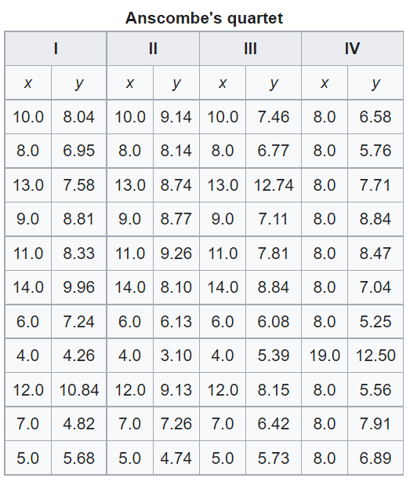
Exploratory Data Analysis
Is EDA Necessary?
Notes:
Dataset source <https://www.kaggle.com/code/carlmcbrideellis/anscombe-s-quartet-and-the-importance-of-eda>
https://en.wikipedia.org/wiki/Anscombe%27s_quartet
Anscombe's quartet comprises four dataset hat have nearly identical simple descriptive statistics yet have very different distributions and appear very different when graphed. Each dataset consists of eleven (x,y) points. They were constructed in 1973 by the statistician Francis Anscombe to demonstrate both the importance of graphing data when analyzing it, and the effect of outliers and other influential observations on statistical properties. He described the article as being intended to counter the impression among statisticians that "numerical calculations are exact, but graphs are rough."

Slide 44
Exploratory Data Analysis
Is EDA Necessary?
Descriptive Statistic | Value
Mean of X | 9
Mean of Y | 7.50
STD of X | 3.32
STD of Y | 2.03
Regression line Y on X | y=3.00 +0.50x
Correlation | 0.82
R^2 | 0.67
X & Y are the SAME from a statistical point of view.
Notes:
Dataset source <https://www.kaggle.com/code/carlmcbrideellis/anscombe-s-quartet-and-the-importance-of-eda>
https://en.wikipedia.org/wiki/Anscombe%27s_quartet
Anscombe's quartet comprises four dataset hat have nearly identical simple descriptive statistics yet have very different distributions and appear very different when graphed. Each dataset consists of eleven (x,y) points. They were constructed in 1973 by the statistician Francis Anscombe to demonstrate both the importance of graphing data when analyzing it, and the effect of outliers and other influential observations on statistical properties. He described the article as being intended to counter the impression among statisticians that "numerical calculations are exact, but graphs are rough."

Slide 45
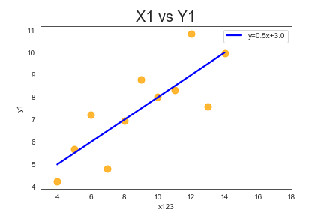
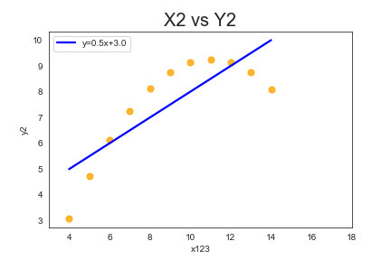
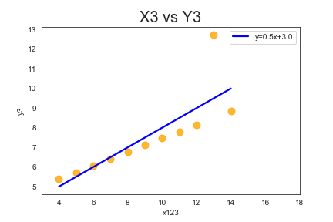
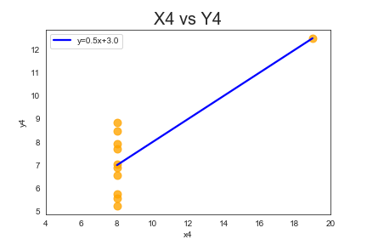
Exploratory Data Analysis
Is EDA Necessary?
Notes:
https://en.wikipedia.org/wiki/Anscombe%27s_quartet
https://www.kaggle.com/code/carlmcbrideellis/anscombe-s-quartet-and-the-importance-of-eda
In Figure 1 the points almost lie along a straight line, and that our straight line model seems to be a reasonable choice.
In Figure 2 the relationship is not linear, the points would really be better fitted by a smooth curve, such as a quadratic model (i.e. y=ax2+mx+cy=ax2+mx+c).
In Figure 3 we see an outlier point, whose removal from the data set would result in a much better fit.
In Figure 4 we see that outcome variables are completely independent of the explanatory variable, and a regression is only possible because of one single point, in this case it is a 'high-leverage' point, i.e. this point is exerting a large (or in this case total) influence on the slope of the fit.

Slide 46
Exploratory Data Analysis
Is EDA Necessary?
Descriptive Statistic | Value
Sample size | 142
Mean of X | 54.26
Mean of Y | 47.83
STD of X | 16.77
STD of Y | 26.94
Correlation | -0.006

Slide 47
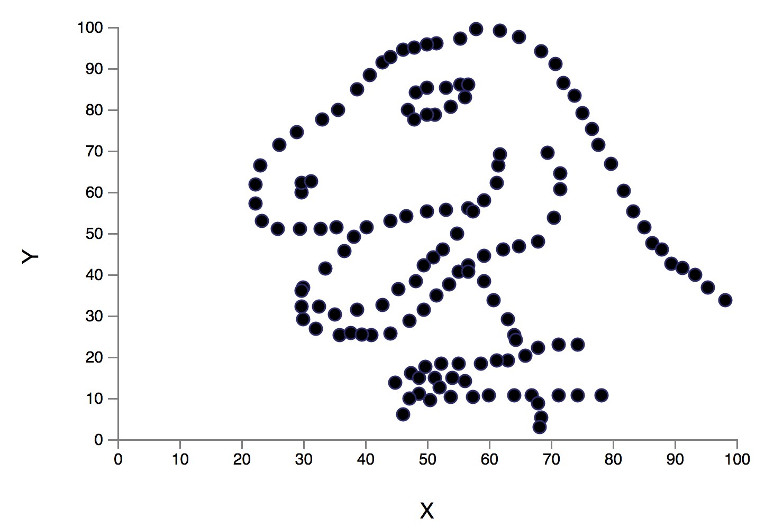
Exploratory Data Analysis
Is EDA Necessary?
Anscombosaurus
Descriptive Statistic | Value
Sample size | 142
Mean of X | 54.26
Mean of Y | 47.83
STD of X | 16.77
STD of Y | 26.94
Correlation | -0.006
"Never trust summary statistics alone; always visualize your data."- Alberto Cairo
Notes:
The Datasaurus Dozen
Recently, Alberto Cairo created the Datasaurus dataset which urges people to "never trust summary statistics alone; always visualize your data", since, while the data exhibits normal seeming statistics, plotting the data reveals a picture of a dinosaur.

Slide 48
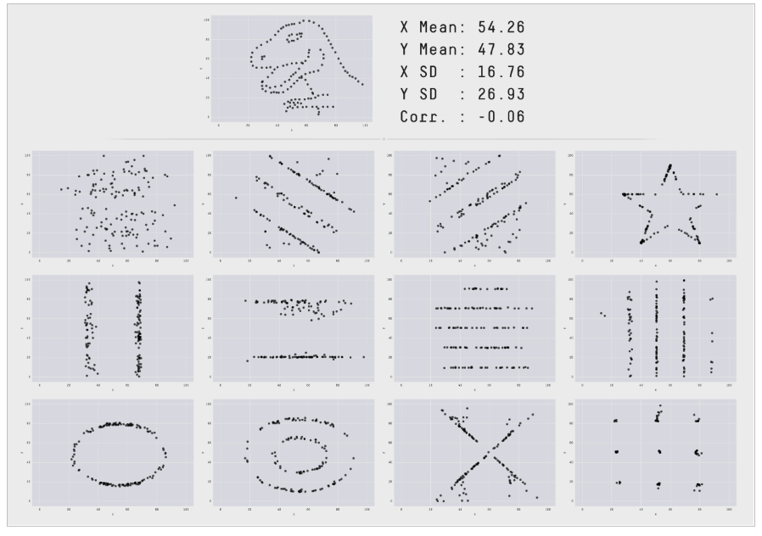
Exploratory Data Analysis
Maybe present, the pictures first, and then present the point that they all share the same stats as dinosaur!
Is EDA Necessary?
by Justin Matejka &
George Fitzmaurice
Notes:
These 13 datasets (the Datasaurus, plus 12 others) each have the same summary statistics (x/y mean, x/y standard deviation, and Pearson's correlation) to two decimal places, while being drastically different in appearance. This work describes the technique we developed to create this dataset, and others like it.

Slide 49
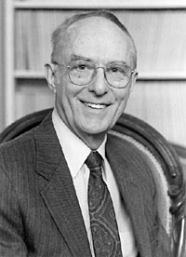
Exploratory Data Analysis
Is EDA Necessary?
Yes, EDA is necessary!
"The moral of the story is look before you leap!"
"Graphs are essential to good statistical analysis."
F. J. Anscombe
Notes:
Dataset source <https://www.kaggle.com/code/carlmcbrideellis/anscombe-s-quartet-and-the-importance-of-eda>
https://en.wikipedia.org/wiki/Anscombe%27s_quartet
Anscombe's quartet comprises four dataset hat have nearly identical simple descriptive statistics yet have very different distributions and appear very different when graphed. Each dataset consists of eleven (x,y) points. They were constructed in 1973 by the statistician Francis Anscombe to demonstrate both the importance of graphing data when analyzing it, and the effect of outliers and other influential observations on statistical properties. He described the article as being intended to counter the impression among statisticians that "numerical calculations are exact, but graphs are rough."

Slide 50
Exploratory Data Analysis
EDA & Statistics
This is the section in which, a background in statistics comes useful, for most of the EDA graphics that one ends up using and relying upon, are indeed based on statistics. Hence, the ability to understand the charts and summaries and their meaning is dependent upon the fact of understanding the statistical implications.
In here, we provide a brief overview of some of the most common terms and graphics that a scientists might end up using, that requires indeed some statistical background- understanding the nuisances, allows for a better choice making in the next step of the analysis.
Notes:
Further Notes

Slide 51
Exploratory Data Analysis
EDA (Stats Review)
Statistics, collection of procedures and principles for gathering data and analyzing information in order to help people make decisions when faced with uncertainty.
Population, every member of a group of items/individuals which is of interest to a particular question or experiment.
Sample, a subset of the population of interest that is available for examination.
Statistic, summary measure of sample data (e.g. mean).
Sample size, size of subset (i.e. total observations present in dataset).
Descriptive Stats, description of data through numerical and graphical summaries.
Numerical summary, a collection of statistics (e.g. mean, median, standard deviation, ...) used to describe a specific characteristic about a data set.
Visual summaries, a graphical representation of the data.
Robust, not sensitive to extreme values
Notes:
Further Notes

Slide 52
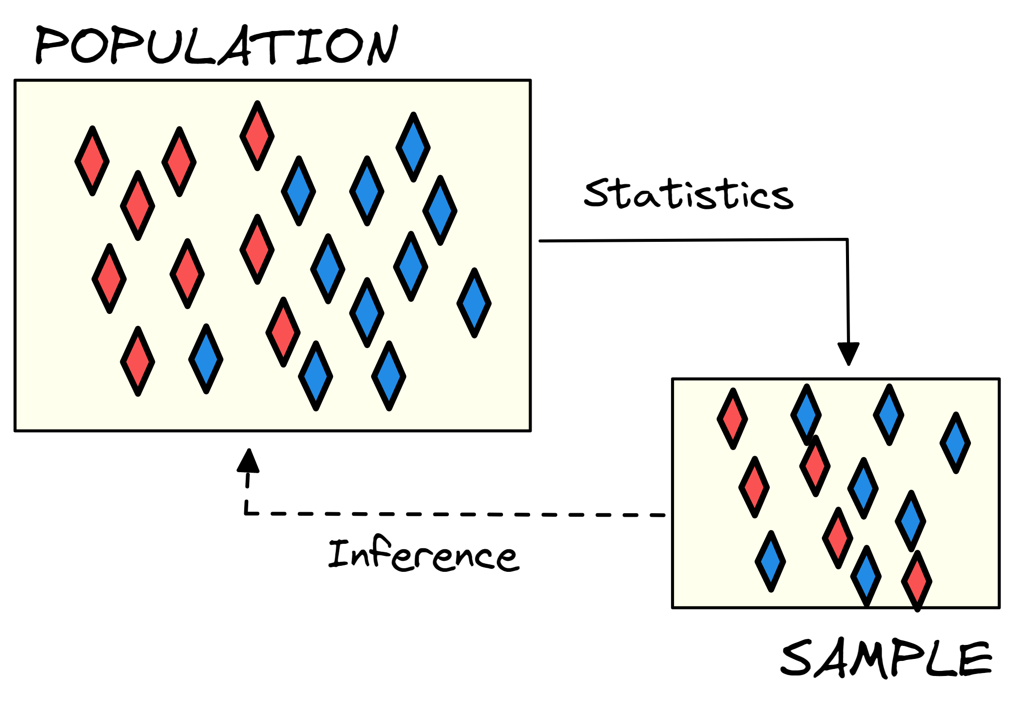
Exploratory Data Analysis
EDA (Stats Review)
Notes:
Further Notes
https://www.stat.cmu.edu/~hseltman/309/Book/chapter4.pdf
"Non-graphical methods generally involve calculation of summary statistics, while graphical methods obviously summarize the data in a diagrammatic or pictorial way. Univariate methods look at one variable (data column) at a time, while multivariate methods look at two or more variables at a time to explore relationships. Usually our multivariate EDA will be bivariate (looking at exactly two variables), but occasionally it will involve three or more variables. It is almost always a good idea to perform univariate EDA on each of the components of a multivariate EDA before performing the multivariate EDA."

Slide 53
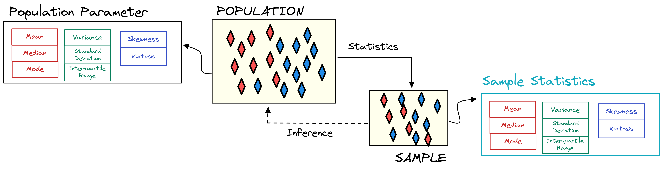
Exploratory Data Analysis
EDA (Stats Review)
Notes:
Further Notes
https://www.stat.cmu.edu/~hseltman/309/Book/chapter4.pdf
"Non-graphical methods generally involve calculation of summary statistics, while graphical methods obviously summarize the data in a diagrammatic or pictorial way. Univariate methods look at one variable (data column) at a time, while multivariate methods look at two or more variables at a time to explore relationships. Usually our multivariate EDA will be bivariate (looking at exactly two variables), but occasionally it will involve three or more variables. It is almost always a good idea to perform univariate EDA on each of the components of a multivariate EDA before performing the multivariate EDA."

Slide 54
Exploratory Data Analysis
Types of EDA
Exploratory data analysis is generally cross-classified in two ways. First, each method is either non-graphical or graphical. And second, each method is either univariate or multivariate (usually just bivariate).
Univariate (numerical/graphical), simplest form of data analysis, where the data being analyzed consists of just one variable. It can be comprised of both numerical and graphical summaries. Some of the most common are: histograms, box-plots, and stem-and-leaf plots.
Multivariate (numerical/ graphical), arises from more than one variable; generally used to show the relationship between two or more variables of the data through cross-tabulation, statistics, or graphics. Some common charts are scatter plots, heat maps, bubble charts.
Notes:
Further Notes
EDA postpones the usual assumptions about what kind of model the data follow, with the more direct approach of allowing the data itself to reveal its underlying structure and model.
EDA is not a mere collection of techniques; EDA is a philosophy as to how we dissect a data set; what we look for; how we look; and how we interpret; and it does so by making use of graphics.
Check out this section
https://www.stat.cmu.edu/~hseltman/309/Book/chapter4.pdf

Slide 55
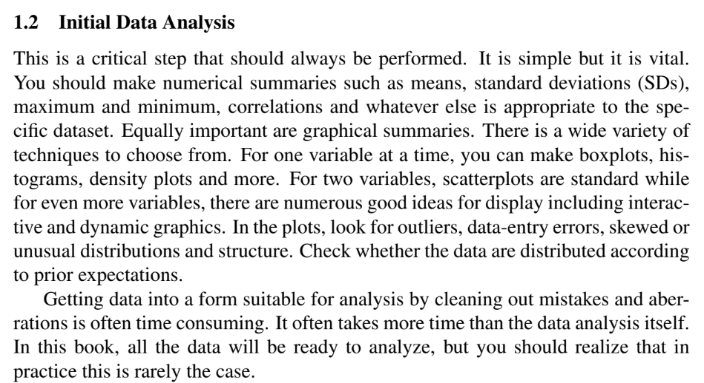
Exploratory Data Analysis
EDA in Practice
EDA allows to gain a grasp of the data and its predictive possibilities, although simple, it is vital. In practice, this means making numerical summaries of each variable such as means, standard deviations, maximum and minimum, correlations, and whatever other statistics that is appropriate to the dataset.
Equally important are graphical summaries. There are many possible graphics at one's disposition. Generally, in order to represent a single variable, one can use - boxplots, histograms, density plots, stem and leaf plots, QQ plots, bar graphs, line charts, area charts, …. For two or more variables- scatterplots, heat maps, contour plots,… can be used.
"The summaries should be used to understand the data and spot possible outliers, distributions, errors, peculiar structures, and any other interesting event."
Notes:
Further Notes

Slide 56
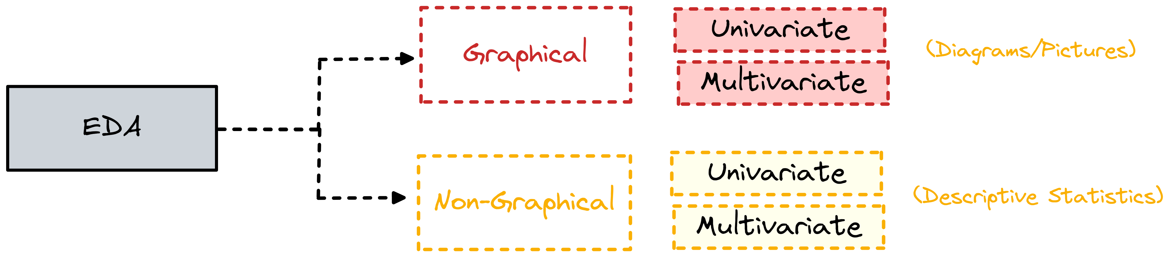
Exploratory Data Analysis
Types of EDA
Notes:
Further Notes
https://www.stat.cmu.edu/~hseltman/309/Book/chapter4.pdf
"Non-graphical methods generally involve calculation of summary statistics, while graphical methods obviously summarize the data in a diagrammatic or pictorial way. Univariate methods look at one variable (data column) at a time, while multivariate methods look at two or more variables at a time to explore relationships. Usually our multivariate EDA will be bivariate (looking at exactly two variables), but occasionally it will involve three or more variables. It is almost always a good idea to perform univariate EDA on each of the components of a multivariate EDA before performing the multivariate EDA."

Slide 57
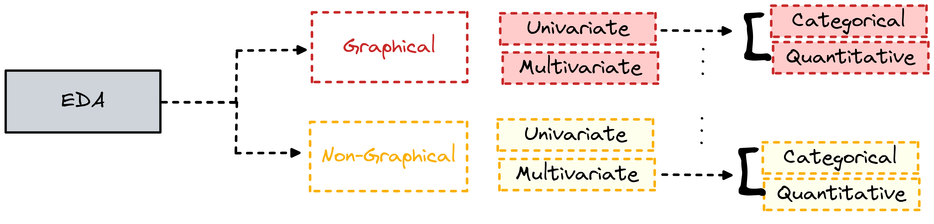
Exploratory Data Analysis
Types of EDA
Often, the type of data, categorical or quantitative, will determine the kind of graphics that will be used.
Notes:
Further Notes
https://www.stat.cmu.edu/~hseltman/309/Book/chapter4.pdf
"Non-graphical methods generally involve calculation of summary statistics, while graphical methods obviously summarize the data in a diagrammatic or pictorial way. Univariate methods look at one variable (data column) at a time, while multivariate methods look at two or more variables at a time to explore relationships. Usually our multivariate EDA will be bivariate (looking at exactly two variables), but occasionally it will involve three or more variables. It is almost always a good idea to perform univariate EDA on each of the components of a multivariate EDA before performing the multivariate EDA."

Slide 58

Exploratory Data Analysis
Non-Graphical Categorical
"The characteristics of interest for a categorical variable are simply the range of values and the frequency of occurrence for each value." Hence, a tabulation of the frequencies gets the job done!
Statistic | History | English | Math | Other | Total
Count | 100 | 250 | 150 | 70 | 570
Percent | 17.5% | 43.9% | 26.3% | 12.3% | 100%
Hair Color | Value
Black | 100
Blonde | 20
Brown | 30
Red | 5
 | Married | Not Married | Total
Value | 33 | 73 | 106
Notes:
Further Notes
https://www.stat.cmu.edu/~hseltman/309/Book/chapter4.pdf
"Non-graphical methods generally involve calculation of summary statistics, while graphical methods obviously summarize the data in a diagrammatic or pictorial way. Univariate methods look at one variable (data column) at a time, while multivariate methods look at two or more variables at a time to explore relationships. Usually our multivariate EDA will be bivariate (looking at exactly two variables), but occasionally it will involve three or more variables. It is almost always a good idea to perform univariate EDA on each of the components of a multivariate EDA before performing the multivariate EDA."

Slide 59

Exploratory Data Analysis
Non-Graphical Quantitative
"Univariate EDA for a quantitative variable is a way to make preliminary assessments about the population distribution of the variable using the data of the observed sample."
The distribution provides information about the possible values about a variable and the overall pattern of how often the possible value tend to occur.
The characteristics of the population distribution of a quantitative variable are
Center, location of typical or middle values
Spread, how far values are from the center
Shape, symmetric or skewed, tails and body proportions, and number of peaks
"The randomly observed sample are interesting to the degree that they represent the population that it came from."
Notes:
Further Notes
https://www.stat.cmu.edu/~hseltman/309/Book/chapter4.pdf
"Non-graphical methods generally involve calculation of summary statistics, while graphical methods obviously summarize the data in a diagrammatic or pictorial way. Univariate methods look at one variable (data column) at a time, while multivariate methods look at two or more variables at a time to explore relationships. Usually our multivariate EDA will be bivariate (looking at exactly two variables), but occasionally it will involve three or more variables. It is almost always a good idea to perform univariate EDA on each of the components of a multivariate EDA before performing the multivariate EDA."
http://mathcenter.oxford.emory.edu/site/math117/shapeCenterAndSpread/
Shape, Center, Spread

Slide 60
Exploratory Data Analysis
Estimates of Location (center)
The central tendency of a distribution has to do with the "typical" or middle values. The most common measures for central tendency are
Mean , (a.k.a. arithmetic average), sum of the data values divided by total number of values;
Non-robust, extreme values will pull the mean towards them
Median, the middle of the data after is has been written in order (i.e. sorted)
Robust, it is not influenced by extreme values (e.g. outliers)
Mode, the most frequently occurring data value
Notes:
Further Notes
Example of Bill Gates income, if we take mean income of people living around Bill Gates, the mean will be skewed towards a high number;
If we consider the median, than it will fall in the middle of the data, and will not be affected by Bill's extreme income. Hence, robust to extreme
Values.
https://www.stat.cmu.edu/~hseltman/309/Book/chapter4.pdf
Robustness: "A sample statistic is “robust” if moving some data tends not to change the value of the statistic"
Examples
https://www.purplemath.com/modules/meanmode.htm

Slide 61
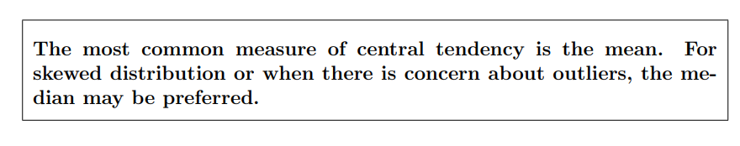
Exploratory Data Analysis
Estimates of Location (center)
from Experimental Design and Analysis by H. J. Seltman
Notes:
Further Notes
https://www.stat.cmu.edu/~hseltman/309/Book/chapter4.pdf
Robustness: "A sample statistic is “robust” if moving some data tends not to change the value of the statistic"

Slide 62
Exploratory Data Analysis
Estimates of Variability (spread)
Spread is an indicator of the variability among the values allowing to summarize the degree of "scatteredness" and how far away they are from the center (e.g. mean).
Range, the distance from the minimum value to the maximum value (max- min)
Non-robust
Quartiles, divide an ordered dataset into four equal parts, and refer to the values of the point between the quarters
Interquartile range (IQR), the difference between quartile 3 and quartile1 (Q3-Q1)
Robust
Variance, standard measure of the spread of the data around the mean
Non-robust
Standard deviation, is the squared root of the variance, and it is in the same unit of the data making the estimates more interpretable.
Non-robust
Notes:
Further Notes
Spread Def + Examples
https://www.abs.gov.au/websitedbs/D3310114.nsf/home/statistical+language+-+measures+of+spread

Slide 63
Exploratory Data Analysis
Estimates of Variability (spread)
from Experimental Design and Analysis by H. J. Seltman
Notes:
Further Notes

Slide 64
Exploratory Data Analysis
Estimates of Shape
Two additional useful univariate descriptors are the skewness and kurtosis of a distribution.
Skewness, is a measure of asymmetry (lack of symmetry)
Kurtosis, is a measure of “peakedness” allowing to infer whether the data are heavy-tailed or light-tailed relative to a normal distribution. Data sets with high kurtosis tend to have heavy tails, or outliers. Data sets with low kurtosis tend to have light tails, or lack of outliers.
Outliers, there is no generally recognized formal definition for outlier, but usually it they represent values that are outside of the areas of a distribution that would commonly occur
Modality, a description of the number of peaks in a distribution
Notes:
Further Notes
https://www.itl.nist.gov/div898/handbook/eda/section3/eda35b.htm
The skewness for a normal distribution is zero, and any symmetric data should have a skewness near zero. Negative values for the skewness indicate data that are skewed left and positive values for the skewness indicate data that are skewed right. By skewed left, we mean that the left tail is long relative to the right tail. Similarly, skewed right means that the right tail is long relative to the left tail. If the data are multi-modal, then this may affect the sign of the skewness.
The kurtosis for a standard normal distribution is three
https://www.statology.org/skewness-kurtosis-python/
Great article on kurtosis and skewness

Slide 65
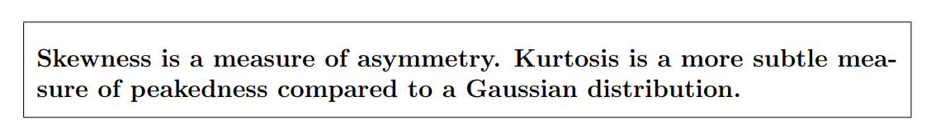
Exploratory Data Analysis
Estimates of Shape
from Experimental Design and Analysis by H. J. Seltman
Notes:
Further Notes

Slide 66
Exploratory Data Analysis
Estimates of Relationship Strength
Correlation, the degree to which two different variables (i.e. measures) are related to one another. Correlations are useful because they can indicate a predictive relationship that can be exploited in practice. However, in general, the presence of a correlation is not sufficient to infer the presence of a causal relationship.
Correlation Coefficient, a number between [-1,1] that signifies the strength and direction of the relationship. A CC of 1, means the that there is a strong positive relation between the two variables; a CC of –1, means that there is strong negative relationship; and a CC score of 0 denotes a weak relationship strength between the two variables (direction + strength).
Covariance, the degree to which one variable changes in synchrony with another. It is best to think of covariance as providing insights into the direction of the relationship.
Notes:
Further Notes

Slide 67
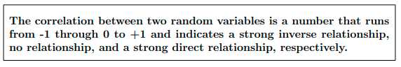
Exploratory Data Analysis
Estimates of Relationship
from Experimental Design and Analysis by H. J. Seltman
Notes:
Further Notes

Slide 68
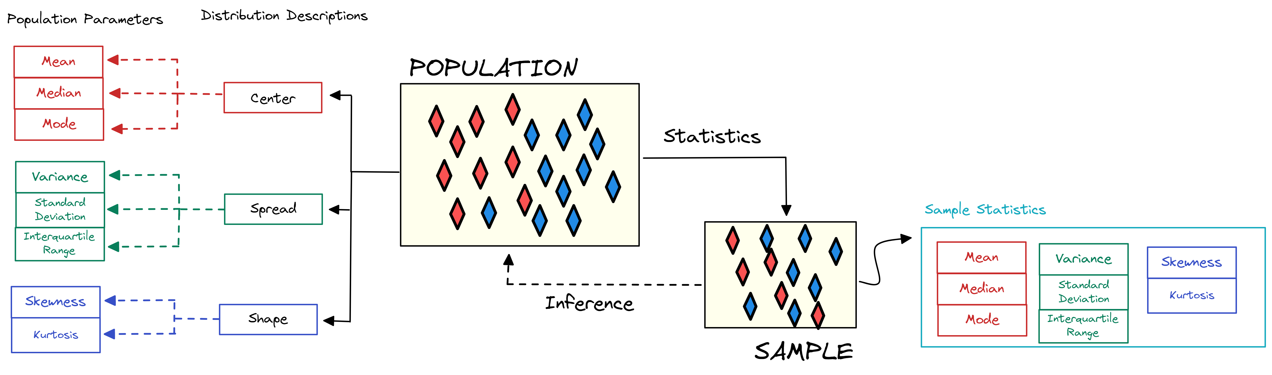
Exploratory Data Analysis
Quantitative Statistics Overview
Notes:
Further Notes
https://www.stat.cmu.edu/~hseltman/309/Book/chapter4.pdf
"Non-graphical methods generally involve calculation of summary statistics, while graphical methods obviously summarize the data in a diagrammatic or pictorial way. Univariate methods look at one variable (data column) at a time, while multivariate methods look at two or more variables at a time to explore relationships. Usually our multivariate EDA will be bivariate (looking at exactly two variables), but occasionally it will involve three or more variables. It is almost always a good idea to perform univariate EDA on each of the components of a multivariate EDA before performing the multivariate EDA."

Slide 69

Exploratory Data Analysis
Graphical Quantitative
Many of numerical estimate for center, spread and shape that we saw in the in non-graphical EDA techniques, appear in the graphical portion EDA techniques. As a result, it is worthwhile to think of graphical EDA as a continuation of the numerical estimates into "graphical estimates" to better understand the distribution at hand.
"Non-graphical and graphical methods complement each other. While the non-graphical methods are quantitative and objective, they do not give a full picture of the data; therefore, graphical methods, which are more qualitative and involve a degree of subjective analysis, are also required."
Notes:
Further Notes
https://www.stat.cmu.edu/~hseltman/309/Book/chapter4.pdf
"Non-graphical methods generally involve calculation of summary statistics, while graphical methods obviously summarize the data in a diagrammatic or pictorial way. Univariate methods look at one variable (data column) at a time, while multivariate methods look at two or more variables at a time to explore relationships. Usually our multivariate EDA will be bivariate (looking at exactly two variables), but occasionally it will involve three or more variables. It is almost always a good idea to perform univariate EDA on each of the components of a multivariate EDA before performing the multivariate EDA."

Slide 70
Exploratory Data Analysis
Histogram
The most basic graph is the histogram, which can be thought of as "a barplot where each bar represents the frequency (count) or proportion (count/total count) of cases for a range of values." Typically the bars run vertically with the count (or proportion) axis running vertically.
The X axis represents the range of data for each bar called a bin
The Y axis represent the total cases in each bin
Generally one will choose between about 5 and 30 bins, depending on the amount of data and the shape of the distribution; this is often an iterative process, where different bin sizes are tried until a "natural" view of the data's distribution appears.
Through an histogram we can better understand the data's shape, center, and spread.
Notes:
Further Notes

Slide 71
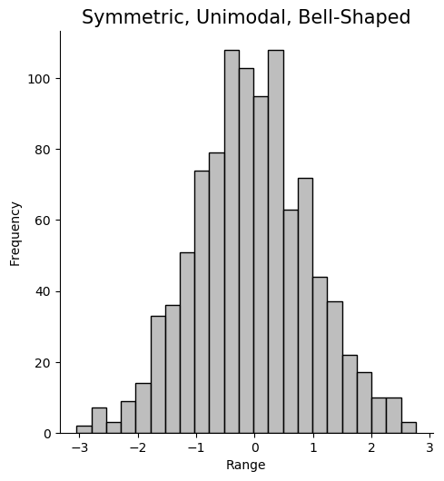
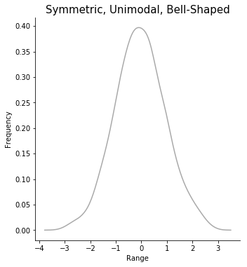
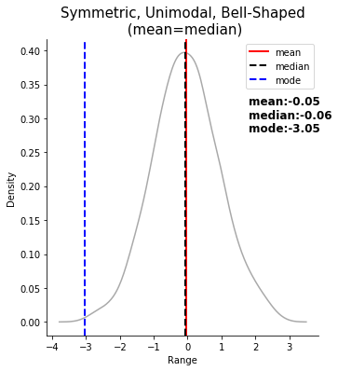
Exploratory Data Analysis
Histogram
Notes:
Further Notes
A note about scale (frequency vs density
https://math.stackexchange.com/questions/2666834/what-is-the-difference-between-frequency-and-density-in-a-histogram
The normal distribution is widely used. Part of the appeal is that it is well behaved and mathematically tractable.

Slide 72
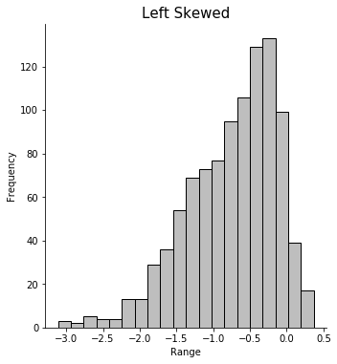
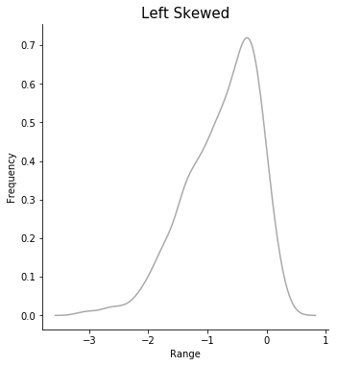
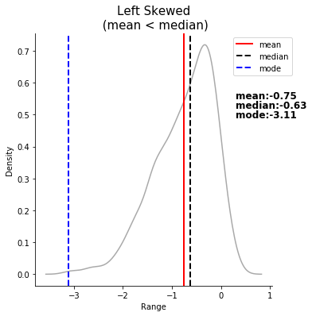
Exploratory Data Analysis
Histogram
Notes:
Further Notes
For a positive skew, values far above the mode are more common than values far below, and the reverse is true for a negative skew.

Slide 73
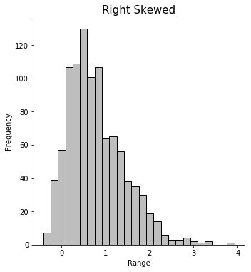
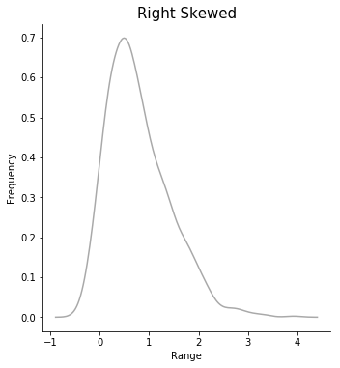
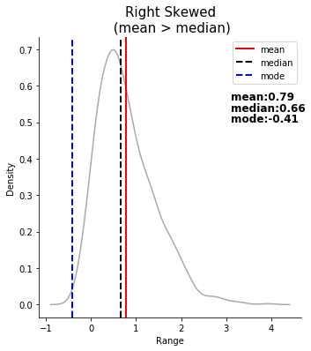
Exploratory Data Analysis
Histogram
Notes:
Further Notes
For a positive skew, values far above the mode are more common than values far below, and the reverse is true for a negative skew.

Slide 74
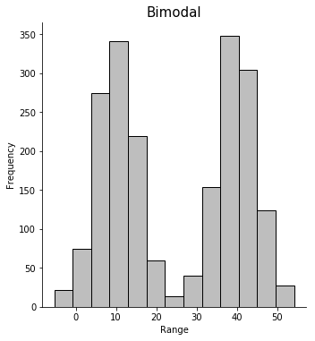


Exploratory Data Analysis
Histogram
Notes:
Further Notes

Slide 75





Exploratory Data Analysis
Histogram
Spread
Notes:
Further Notes

Slide 76
Exploratory Data Analysis
Histogram
Spread
 | <0 | 0 | >0
Skew | left skewed | no skew | right skewed
Kurtosis* | light tailed (playkurtic) | no kurtosis | heavy tailed (lepotokurtic)
*Note: Some formulas report kurtosis as starting at 3 instead of 0; in these slides, we've opted for Fisher’s definition, which subtract 3 from the kurtosis to make it easier to compare with the normal distribution. Using this definition, a distribution would have kurtosis greater than a normal distribution if it had a kurtosis value greater than 0.
Notes:
Further Notes
- https://www.itl.nist.gov/div898/handbook/eda/section3/eda35b.htm
- https://www.statology.org/skewness-kurtosis-python/

Slide 77





Exploratory Data Analysis
Histogram
Spread
Notes:
Further Notes

Slide 78



Exploratory Data Analysis
Histogram
Spread
Notes:
Further Notes

Slide 79

Exploratory Data Analysis
Graphical Quantitative
Histogram
from Experimental Design and Analysis by H. J. Seltman
Notes:
Further Notes

Slide 80
Exploratory Data Analysis
Boxplot
Another very useful univariate graphical technique is the boxplot. It was introduced by John Tukey as the "box-and-whiskers" plot and its strength relies in its ability to quickly glance at the data and its reliance on robust statistics like median and IQR rather than more sensitive ones such as mean and standard deviation.
Boxplots are very good at presenting information about
Central Tendency (median)
Symmetry (whiskers)
Skew (whiskers)
Kurtosis (outliers)
Outliers, any point that is greater than Q3+1.5*IQR & Q1 – 1.5*IQR
*They can be misleading about aspects such as multimodality (multiple peaks)
Notes:
Further Notes
The boxplot information could be appreciated almost as easily if given in non-graphical format. The boxplot is useful because a quick glance can reveal much about the data- symmetry of the distribution and possible evidence of “fat tails”.
Symmetry is appreciated by noticing if the median is in the center of the box and if the whiskers are the same length as each other.
In a skewed distribution we expect to see the median pushed in the direction of the shorter whisker.
If the longer whisker is the top one, then the distribution is positively skewed (or skewed to the right, because higher values are on the right in a histogram).
If the lower whisker is longer, the distribution is negatively skewed (or left skewed.) In cases where the median is closer to the longer whisker it is hard to draw a conclusion.
The term fat tails is used to describe the situation where a histogram has a lot of values far from the mean relative to a Gaussian distribution. This corresponds to positive kurtosis.
In a boxplot, many outliers suggests fat tails (positive kurtosis), or possibly many data entry errors.
Short whiskers suggest negative kurtosis, at least if the sample size is large.

Slide 81

Exploratory Data Analysis
Boxplot
Correct Q3!
Notes:
Further Notes
What is an outlier?
http://mathcenter.oxford.emory.edu/site/math117/shapeCenterAndSpread/

Slide 82



Exploratory Data Analysis
Boxplot
Notes:
Further Notes

Slide 83

Exploratory Data Analysis
Graphical Quantitative
Boxplot
from Experimental Design and Analysis by H. J. Seltman
Notes:
Further Notes

Slide 84

Exploratory Data Analysis
Scatterplot
Scatterplots are particularly useful and intuitive in showing possible relationships between two numeric variables. The usual convention, is to plot the independent variable on the x axis, and the dependent one on the y axis (granted there is a dependent/independen scenario).
When looking at a scatter plot one can deduct the following about a relationship:
Form (linear, non-linear)
Direction, (positive, negative)
Strength (weak, moderate, strong), this is conveyed through the correlation coefficient
Extreme points (outliers, influential points)
Although, one wants to see patterns in the data, it is important to remember the reminder that "correlation does not mean causation" whenever looking at scatterplots.
Notes:
Further Notes
https://www.stat.cmu.edu/~hseltman/309/Book/chapter4.pdf
"Non-graphical methods generally involve calculation of summary statistics, while graphical methods obviously summarize the data in a diagrammatic or pictorial way. Univariate methods look at one variable (data column) at a time, while multivariate methods look at two or more variables at a time to explore relationships. Usually our multivariate EDA will be bivariate (looking at exactly two variables), but occasionally it will involve three or more variables. It is almost always a good idea to perform univariate EDA on each of the components of a multivariate EDA before performing the multivariate EDA."

Slide 85


Exploratory Data Analysis
Scatterplot
Notes:
Further Notes

Slide 86


Exploratory Data Analysis
Scatterplot
Notes:
Further Notes

Slide 87



Exploratory Data Analysis
Scatterplot
Notes:
Further Notes

Slide 88


Exploratory Data Analysis
Scatterplot
Notes:
Further Notes

Slide 89



Exploratory Data Analysis
Graphical Categorical
When we wish to visualize the distribution of a single categorical variable, bar graphs are some of the most popular choices, for it can depict both nominal and ordinal types of data.
Another example is the pie char.
Create these charts on your own!
Notes:
Further Notes
Graphs from:
https://r-charts.com/part-whole/pie-chart-categorical/
https://seaborn.pydata.org/tutorial/categorical.html

Slide 90
Exploratory Data Analysis
EDA in Practice
Often, the type of data, categorical or quantitative, will determine the kind of graphics that will be used.
Categorical Data
Bar graph, pie charts, frequency tables, …
Quantitative Data
Histogram, QQ plot, time plot, box plot, scatter plot, ...
"The whole purpose of using data visualization is to make data communication more efficient." Sara, Metwalli
Notes:
Further Notes
More info about charts
- https://chartio.com/learn/charts/essential-chart-types-for-data-visualization/
- https://blog.hubspot.com/marketing/types-of-graphs-for-data-visualization

Slide 91

Exploratory Data Analysis
Graphics by Data Type
Notes:
Further Notes

Slide 92

Exploratory Data Analysis
Chart
Chooser
Notes:
Further Notes

Slide 93

Exploratory Data Analysis
EDA in a Nutshell
Notes:
Further Notes

Slide 94

Exploratory Data Analysis
The Danger of Bad Graphics
Notes:
Further Notes
"This graph makes our welfare problem look like it’s spiraling out of control. But note where the y-axis starts…at 94 million!"

Slide 95

Exploratory Data Analysis
The Danger of Bad Graphics
Notes:
Further Notes
"Fox News showed this chart of what would happen if the Bush tax cuts expired. Disastrous, right? Again, check the scale (it starts at 34). All is not what it seems."

Slide 96

Exploratory Data Analysis
The Danger of Bad Graphics
Notes:
Further Notes
"Just plain wrong. A Pie chart should add to 100% and not 193%"

Slide 97

Exploratory Data Analysis
The Danger of Bad Graphics
Notes:
Further Notes
“Fox’s 108.6 million figure for the number of “people on welfare” comes from a Census Bureau’s account…of participation in means-tested programs, which include “anyone residing in a household in which one or more people received benefits” in the fourth quarter of 2011, thus including individuals who did not themselves receive government benefits. On the other hand, the “people with a full time job” figure Fox used included only individuals who worked, not individuals residing in a household where at least one person works.”

Slide 98

Exploratory Data Analysis
The Danger of Bad Graphics
Notes:
Further Notes
"It only shows the first half of the year, so of course temperatures are rising dramatically."

Slide 99
Exploratory Data Analysis
EDA's Objective
As data cleaning, EDA is also time consuming and very much an iterative process with no clear beginning nor end. Yet, its objective should be that of bringing forth the data's insights and structures- "the bones of the data" so to speak.
EDA should aid an analyst to
Better understand the data and its scope
Find general patterns and structures
Detect any anomalies and "surprising/strange" patterns
Find if there's missing data (e.g. not enough representation in a particular category)
Determine possible testable hypothesis
Determine possible models suited for the data and accompanying assumptions
"Exploratory data visualizations are intended to facilitate a data analyst’s understanding of the data." -Michael Driscoll
Notes:
Further Notes

Slide 100
Exploratory Data Analysis
EDA Closing Remarks
One should make numerical summaries such as means, standard deviations (SDs), maximum and minimum, correlations and whatever else is appropriate to the specific dataset.
Equally important are graphical summaries. There is a wide variety of techniques to choose from. For one variable at a time, you can make boxplots, histograms, density plots and more. For two variables, scatterplots are standard while for even more variables, there are numerous good ideas for display including interactive and dynamic graphics.
In the plots, look for outliers, data-entry errors, skewed or unusual distributions and structure. Check whether the data are distributed according to prior expectations.
Getting data into a form suitable for analysis by cleaning out mistakes and aberrations is often time consuming. It often takes more time than the data analysis itself.
From "Linear Models in R" by Julian Faraway
Notes:
Further Notes

Slide 101

Exploratory Data Analysis
"The Beauty of Data Visualizations"
Watch this video.
Notes:
Further Notes
Explain what this video covers, and why it is useful.

Slide 102
Exploratory Data Analysis
Further Resources
EDA
https://www.itl.nist.gov/div898/handbook/eda/eda.htm
https://r4ds.had.co.nz/exploratory-data-analysis.html
https://www.epa.gov/caddis-vol4/exploratory-data-analysis
https://towardsdatascience.com/exploratory-data-analysis-8fc1cb20fd15
https://www.jstor.org/stable/2237638
Visualizations
https://blog.hubspot.com/marketing/types-of-graphs-for-data-visualization
https://www.kdnuggets.com/2021/08/visualization-transforming-exploratory-data-analysis.html
https://tutorials.methodsconsultants.com/posts/introduction-to-data-visualization/
https://www.visual-literacy.org/periodic_table/periodic_table.html
https://medriscoll.com/2009/05/27/the-three-sexy-skills-of-data-geeks/
Notes:
Further Explanation

Slide 103
Exploratory Data Analysis
Further Resources
Slides, Courses for Stats & EDA
http://mathcenter.oxford.emory.edu/site/math117/shapeCenterAndSpread/
https://www.gs.washington.edu/academics/courses/akey/56008/lecture/lecture2.pdf
https://github.com/cs109/2015/blob/master/Lectures/03-EDA.pdf
https://online.stat.psu.edu/stat200/
https://onlinestatbook.com/2/index.html
http://www.stat.yale.edu/Courses/1997-98/101/stat101.htm
Books
https://www.amazon.com/gp/product/0201076160/ref=as_li_ss_il?ie=UTF8&camp=1789&creative=390957&creativeASIN=0201076160&linkCode=as2&tag=udacity-20
https://www.stat.cmu.edu/~hseltman/309/Book/chapter4.pdf
Notes:
Further Explanation

Slide 104
Exploratory Data Analysis
EDA IN PRACTICE
Git Hub Repository – develop EDA for Cereal Dataset Asap

